Slide 1
Go
Why Golang? (this is a great article)

Slide 2
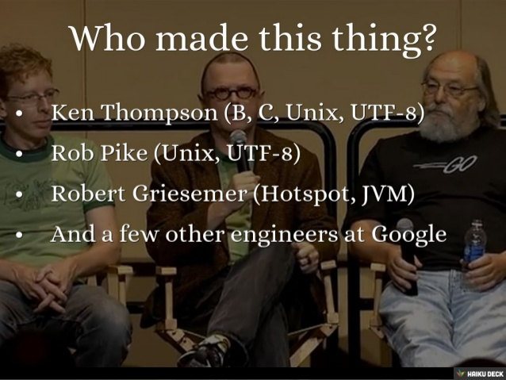
Go was invented by geniuses

Slide 3
performant
multiple-cores
concurrency
compiled
network

Slide 4
clean syntax
powerful standard library
garbage collected

Slide 5
portable
compiles on many OS’s
Notes:
http://www.infoworld.com/article/2896575/google-go/googles-go-language-pros-and-cons.html

Slide 6
backed by Google

Slide 7
open source

Slide 8
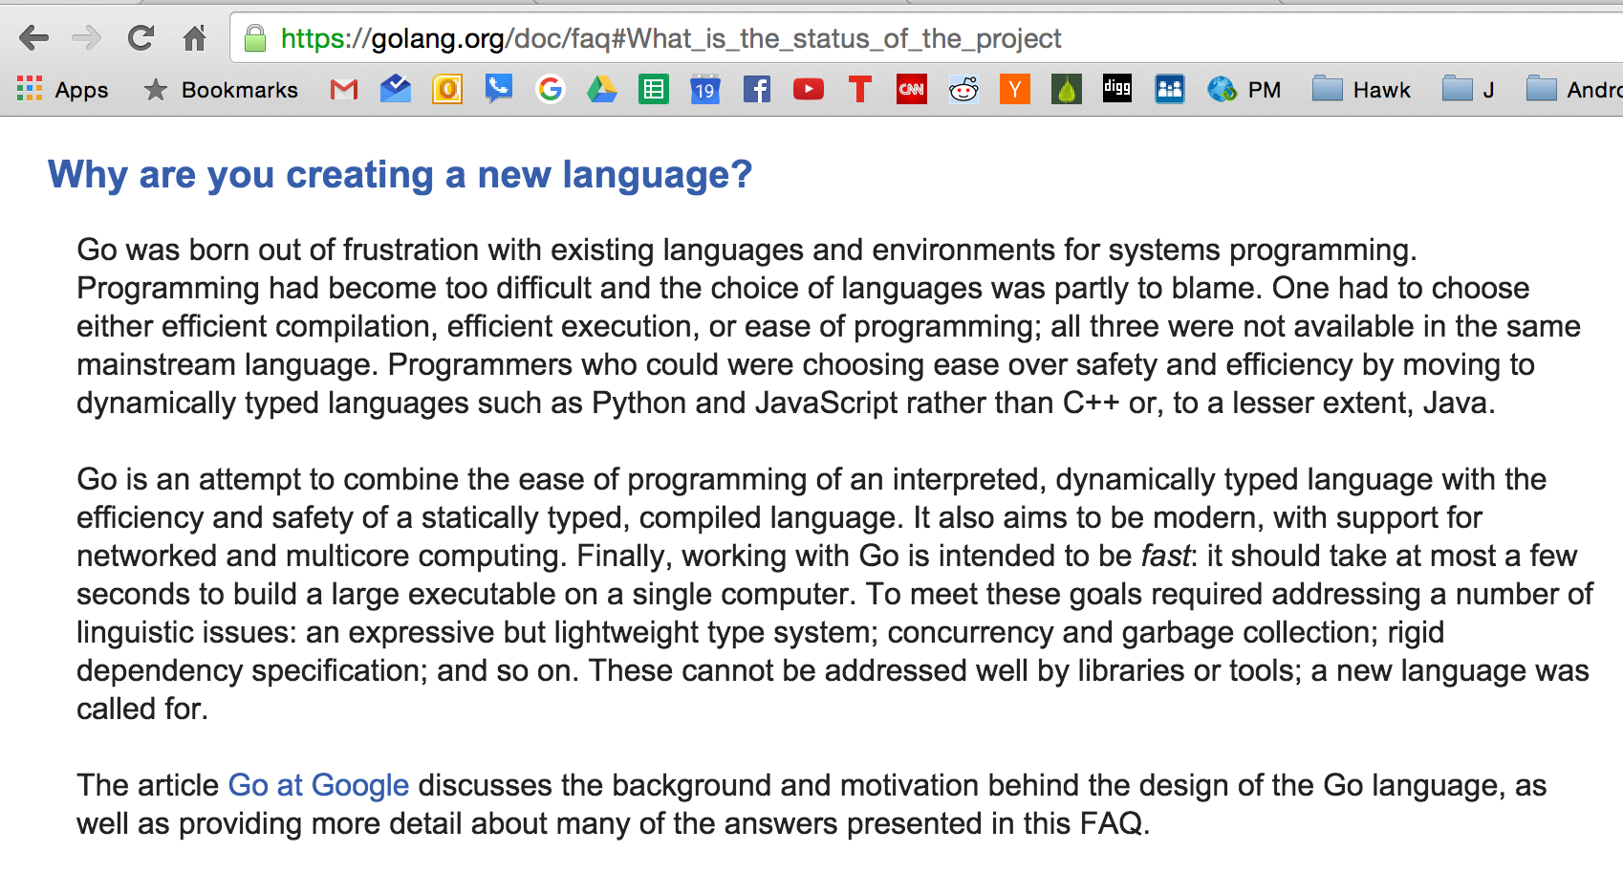

Slide 9
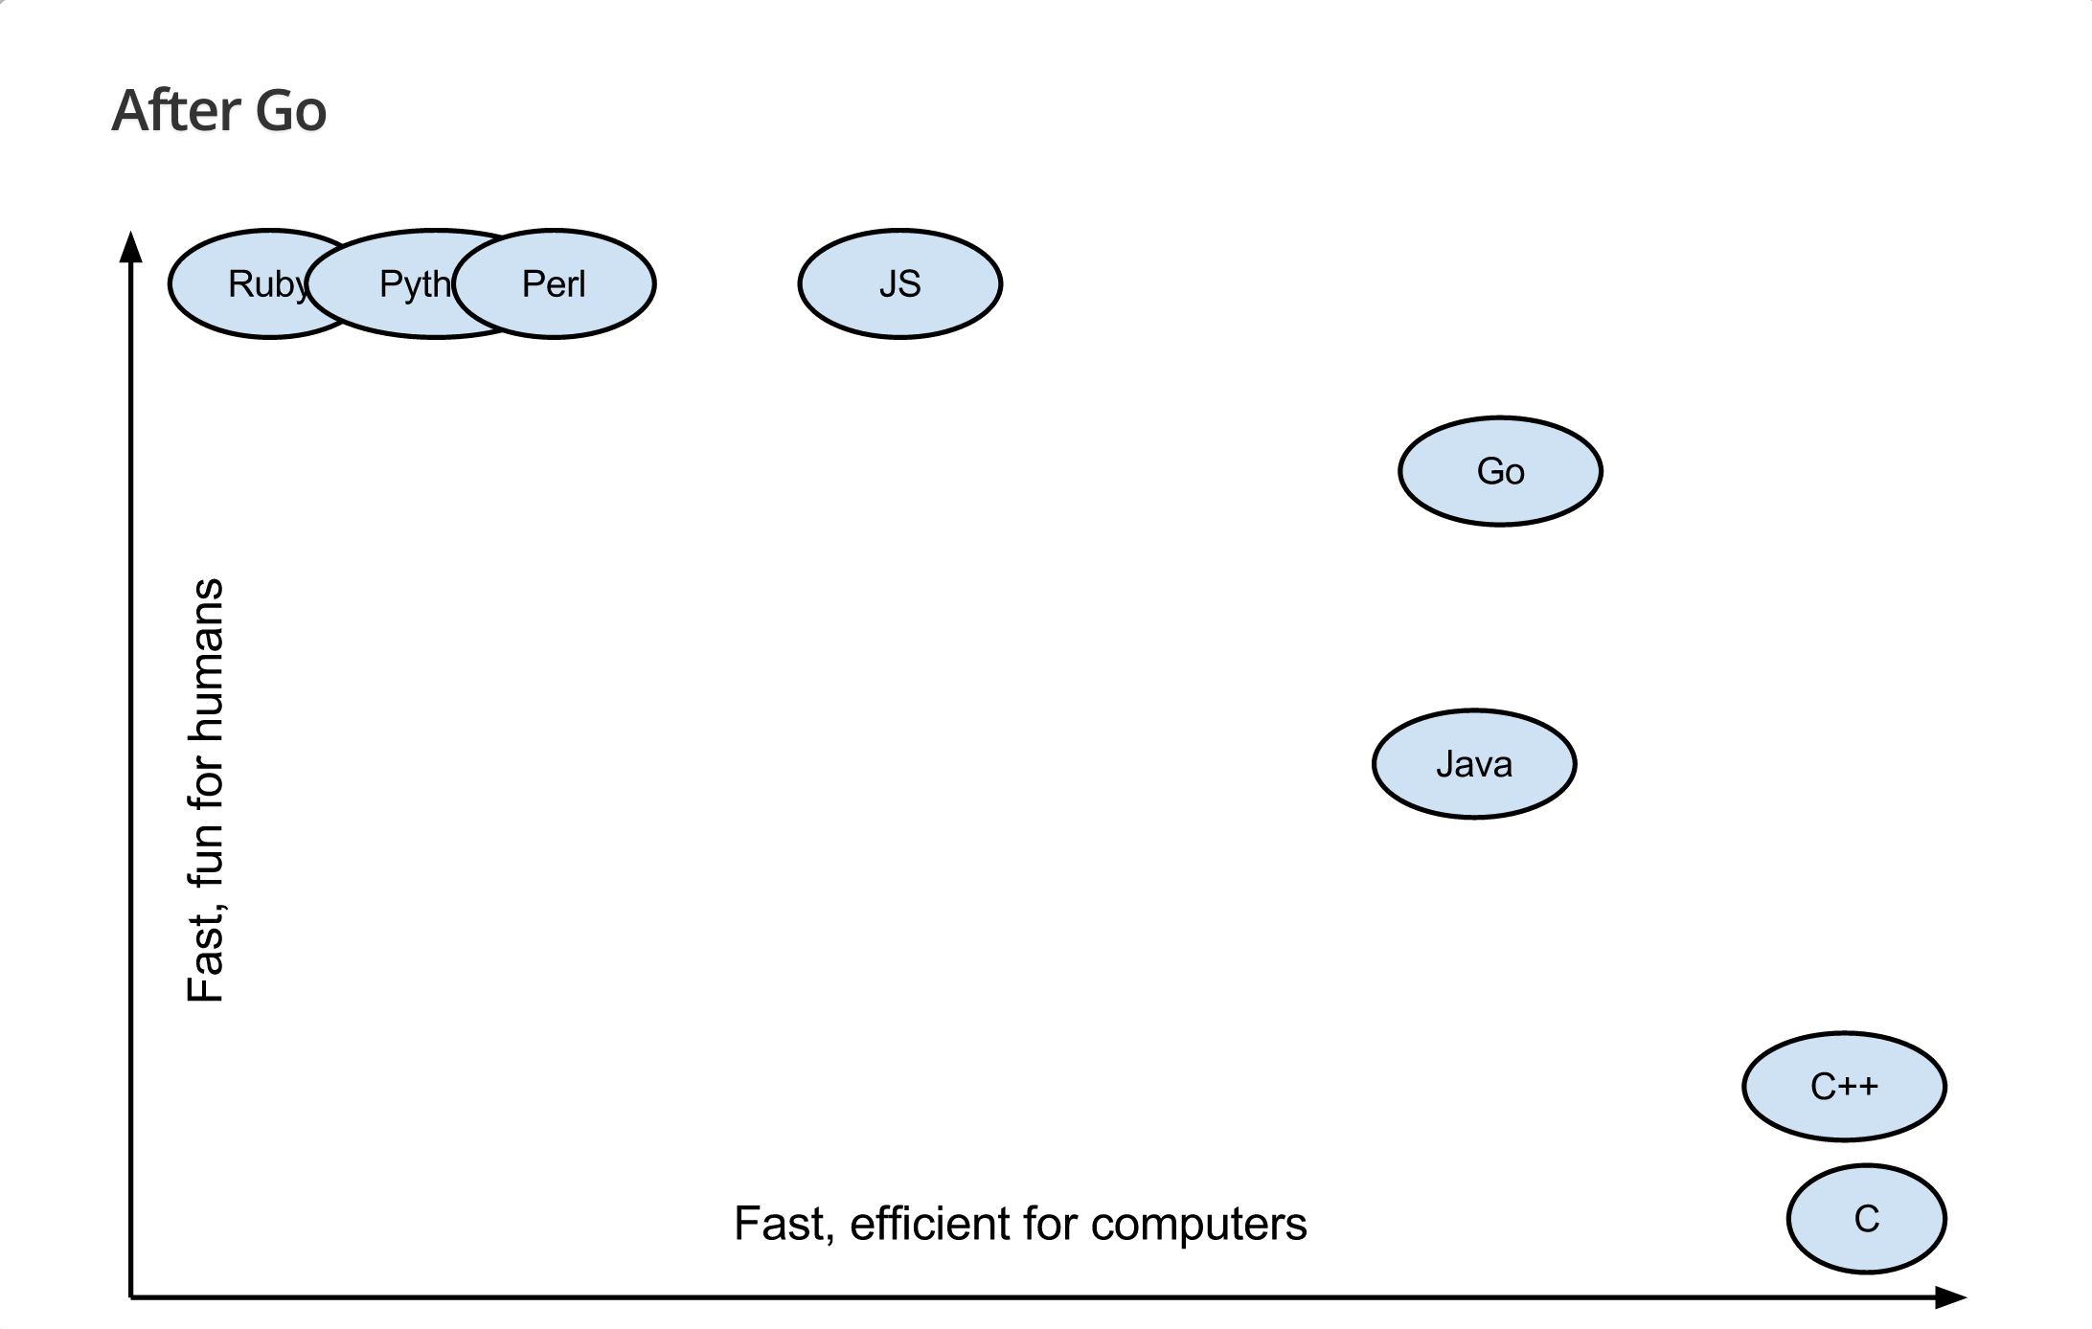
source: Brad Fitzpatrick
Notes:
"GoCon Tokyo" ~ May 31, 2014 ~ Brad Fitzpatrick

Slide 10
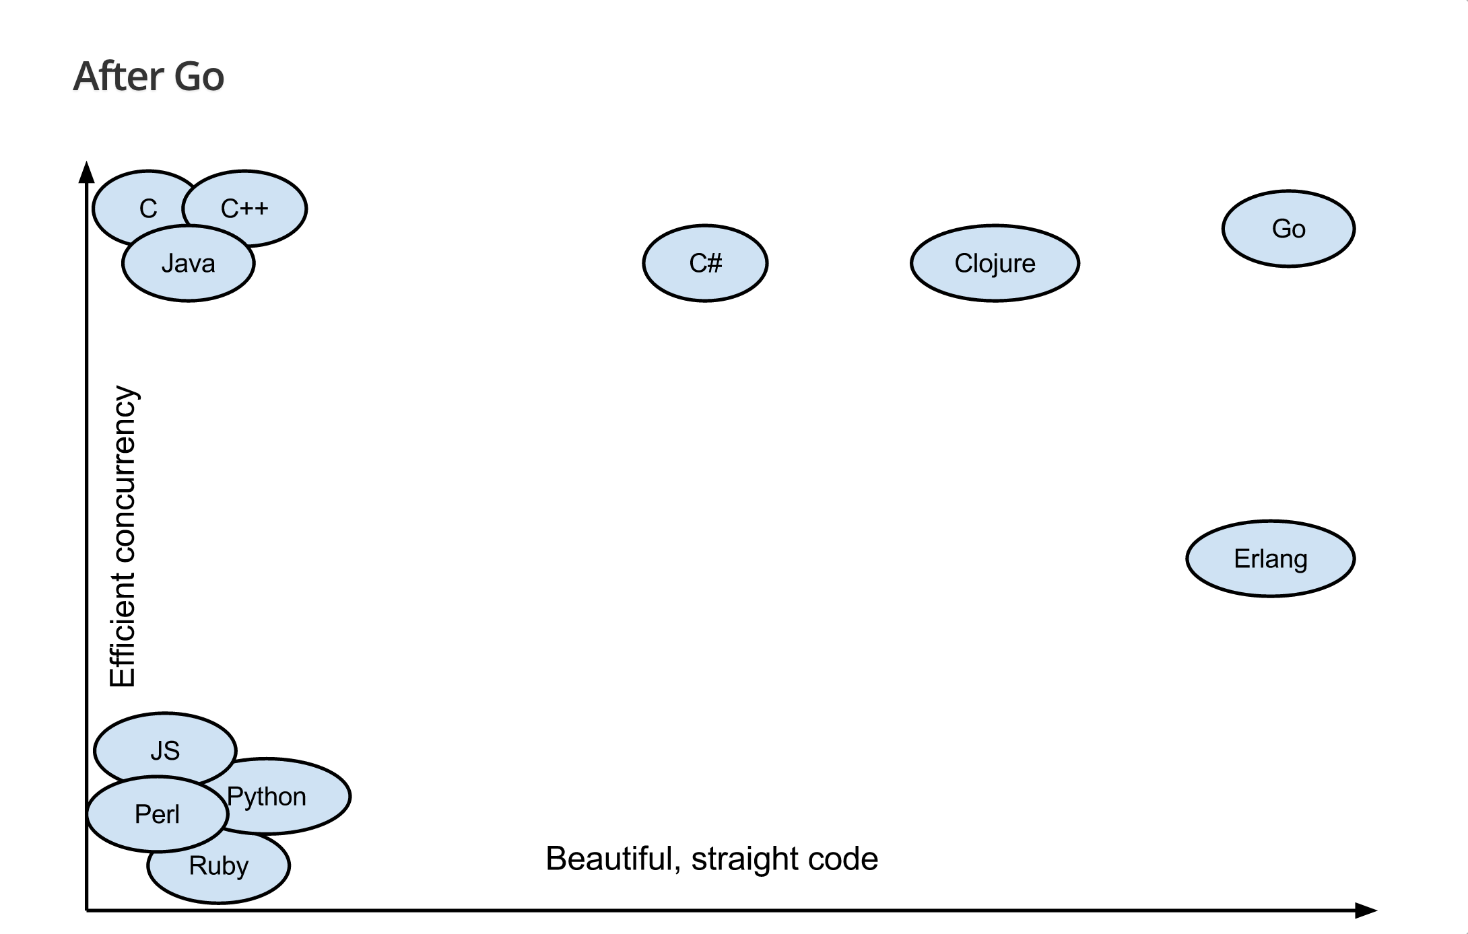
source: Brad Fitzpatrick
Notes:
"GoCon Tokyo" ~ May 31, 2014 ~ Brad Fitzpatrick

Slide 11
“Go has its own elegance and programming idioms that make the language productive and fun to code. The language designers set out to create a language that would let them be productive without losing access to the lower-level programming constructs they needed. This balance is achieved through a minimized set of keywords, built-in functions, and syntax. Go also provides a comprehensive standard library. The standard library provides all the core packages programmers need to build real-world web and network based programs.”
~ Bill Kennedy, Go In Action

Slide 12
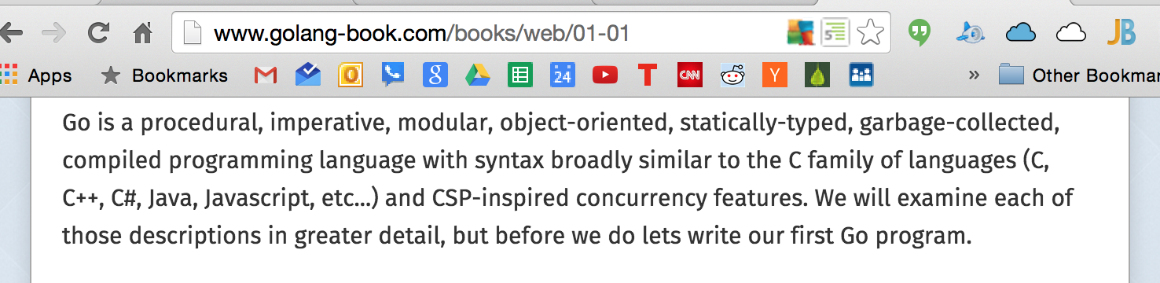
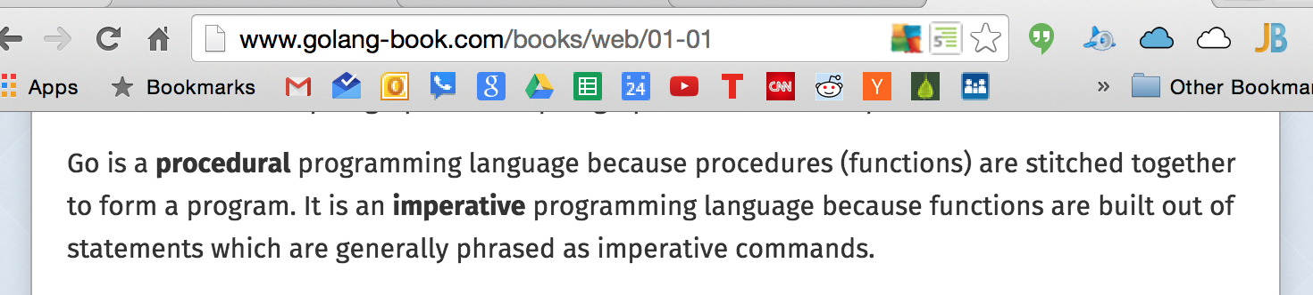

Slide 13
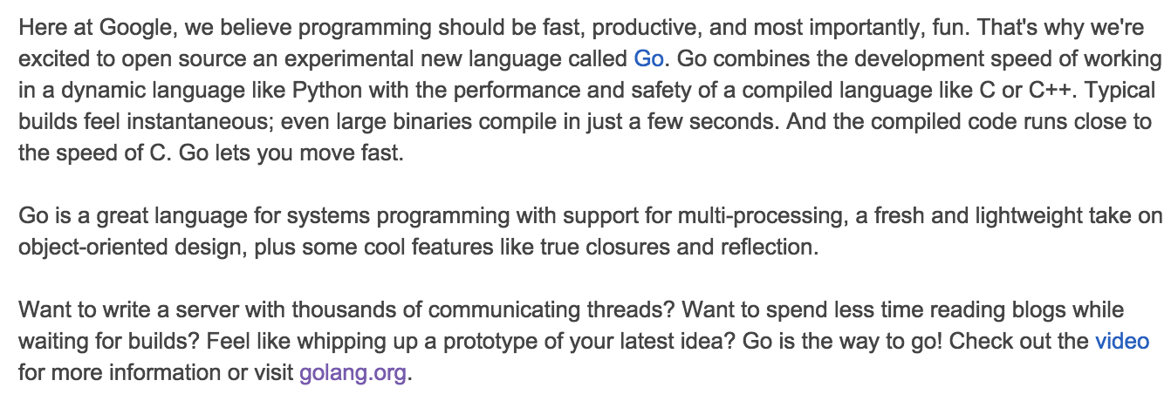
http://google-opensource.blogspot.com/2009/11/hey-ho-lets-go.html

Slide 14
companies using Go

Slide 15


Slide 16


Slide 17


Slide 18


Slide 19






















Slide 20


Slide 21


Slide 22


Slide 23


Slide 24


Slide 25

Notes:
https://www.youtube.com/watch?v=bAQ9ShmXYLY

Slide 26


Slide 27


Slide 28


Slide 29


Slide 30


Slide 31


Slide 32


Slide 33


Slide 34


Slide 35
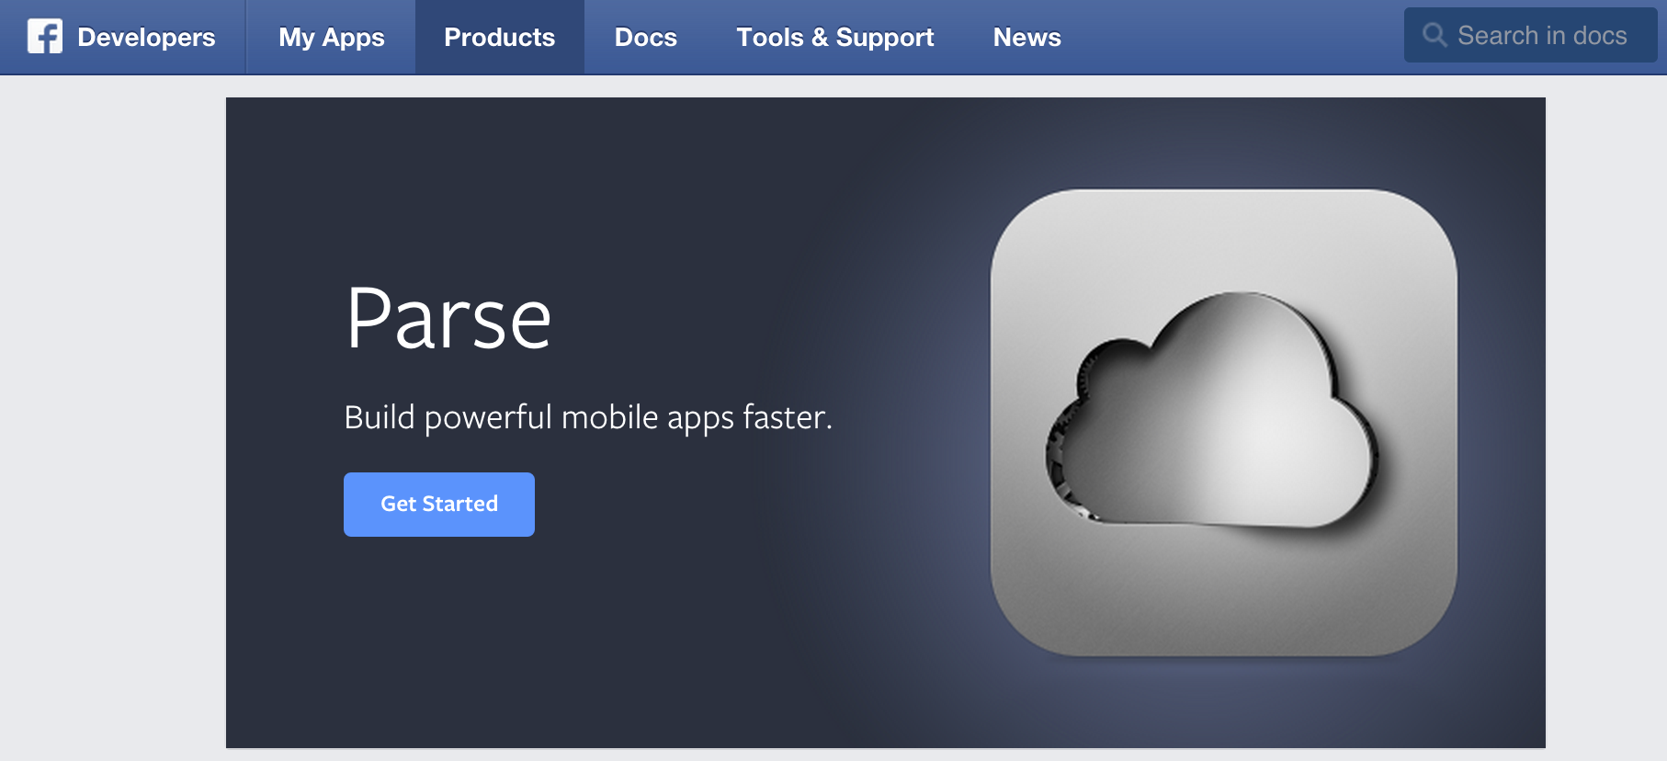

Slide 36
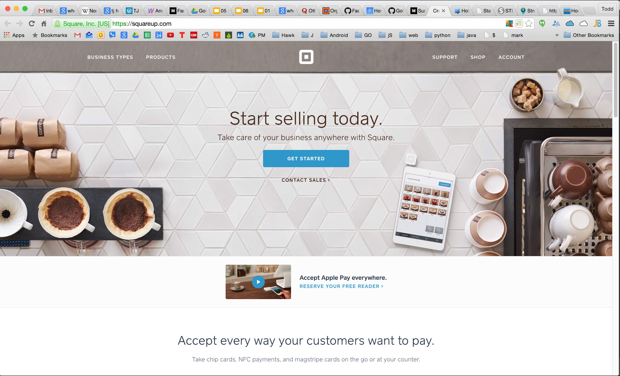

Slide 37
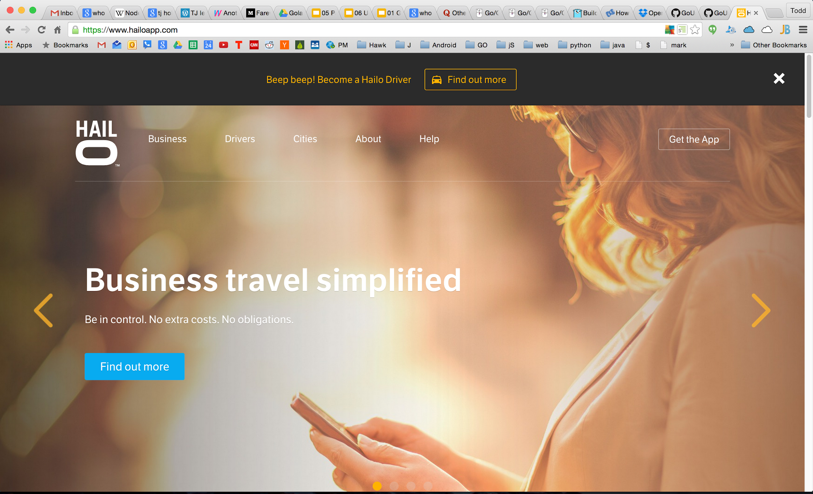

Slide 38


Slide 39
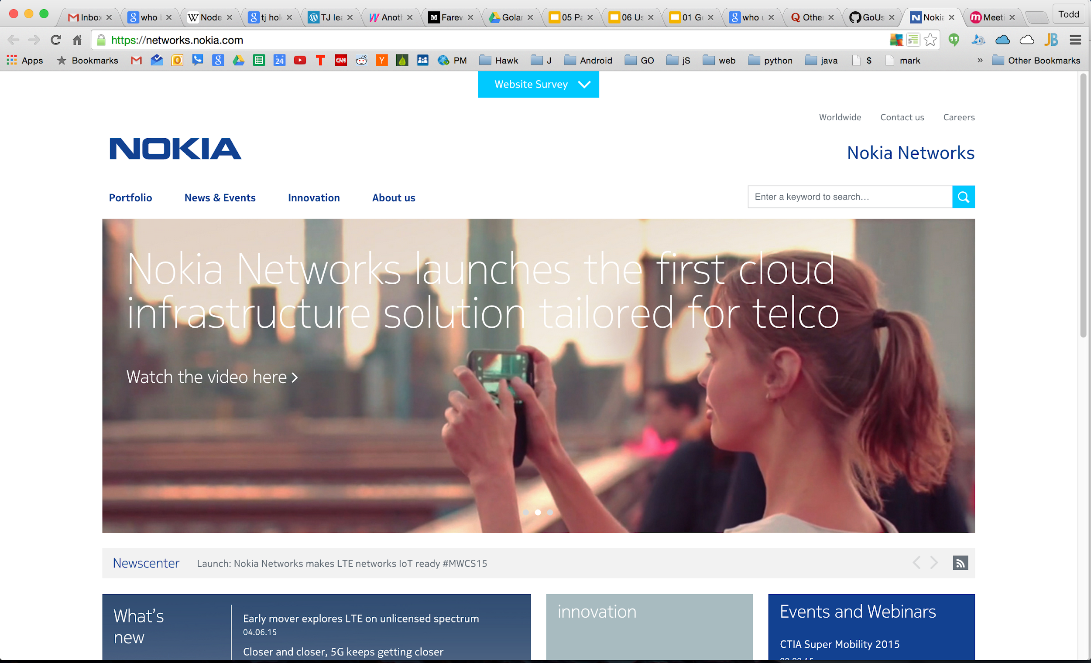

Slide 40
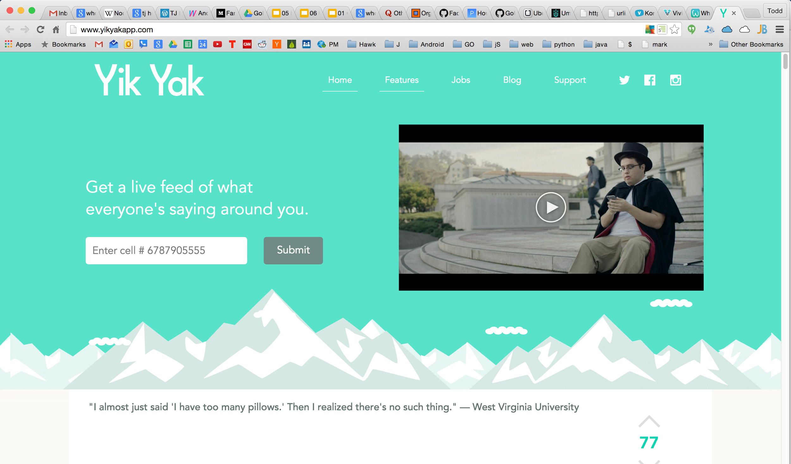

Slide 41
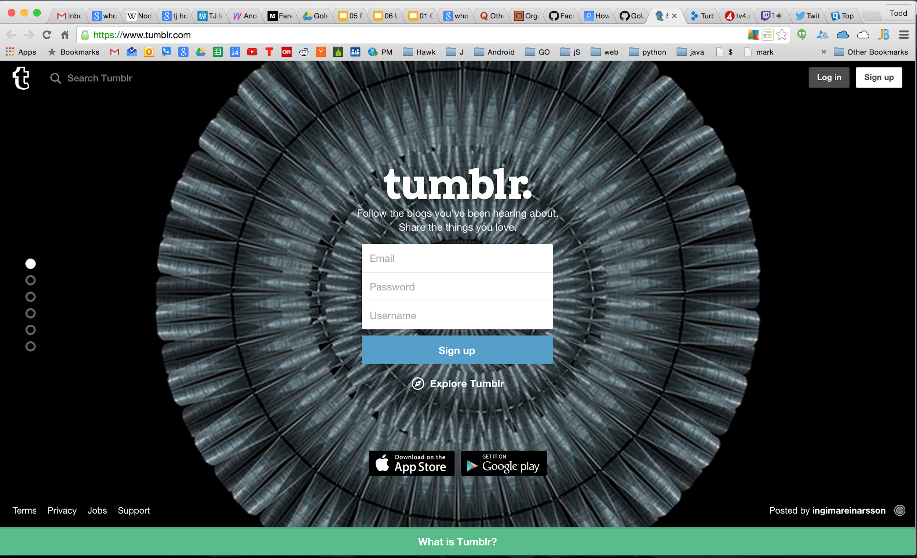

Slide 42
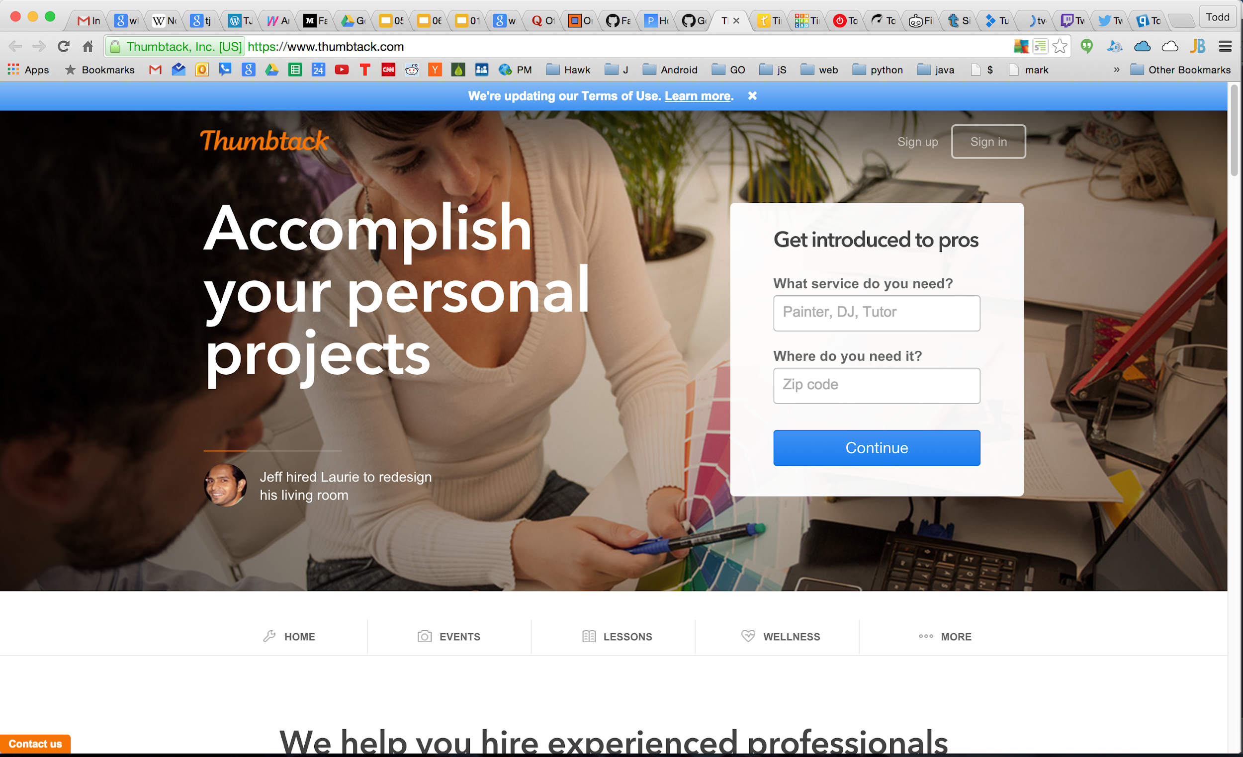

Slide 43


Slide 44
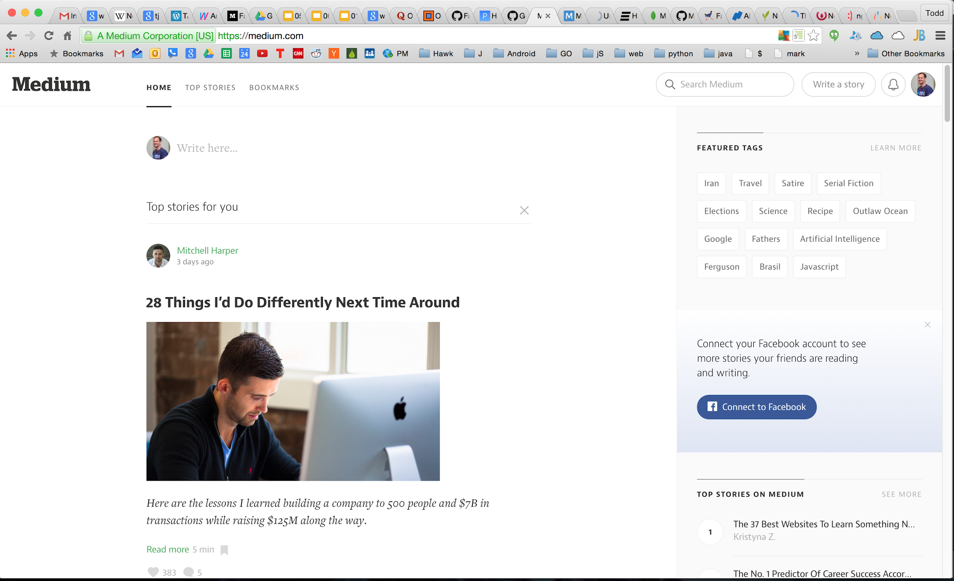

Slide 45


Slide 46


Slide 47


Slide 48
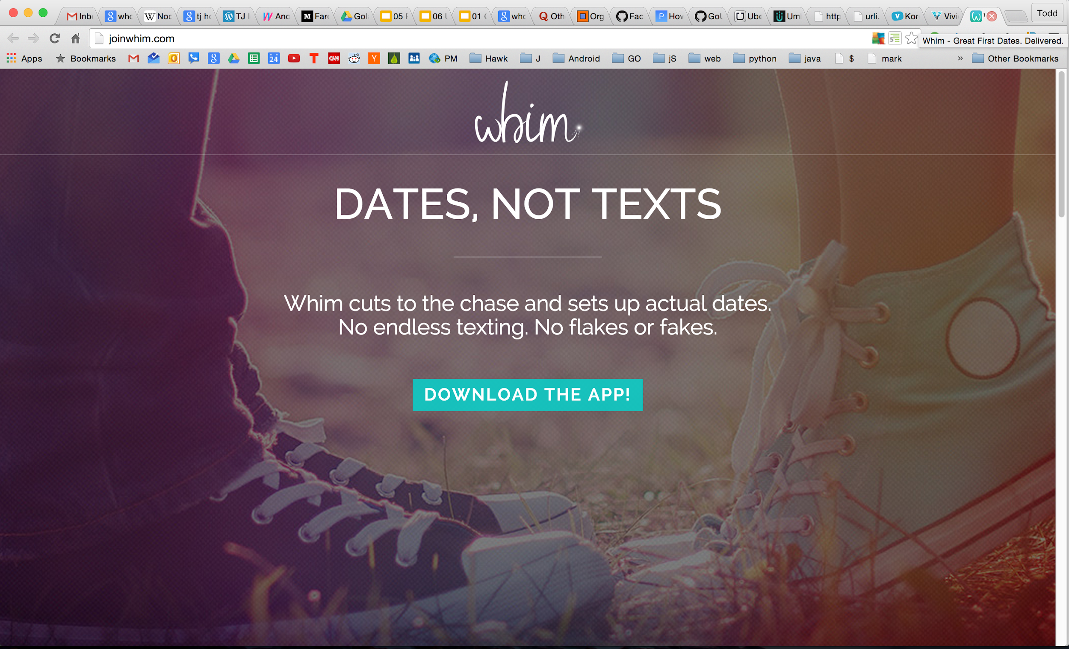

Slide 49


Slide 50


Slide 51
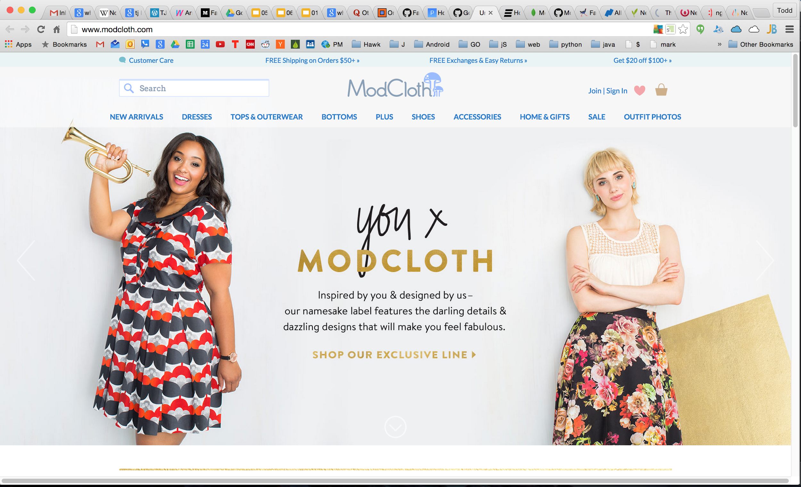

Slide 52
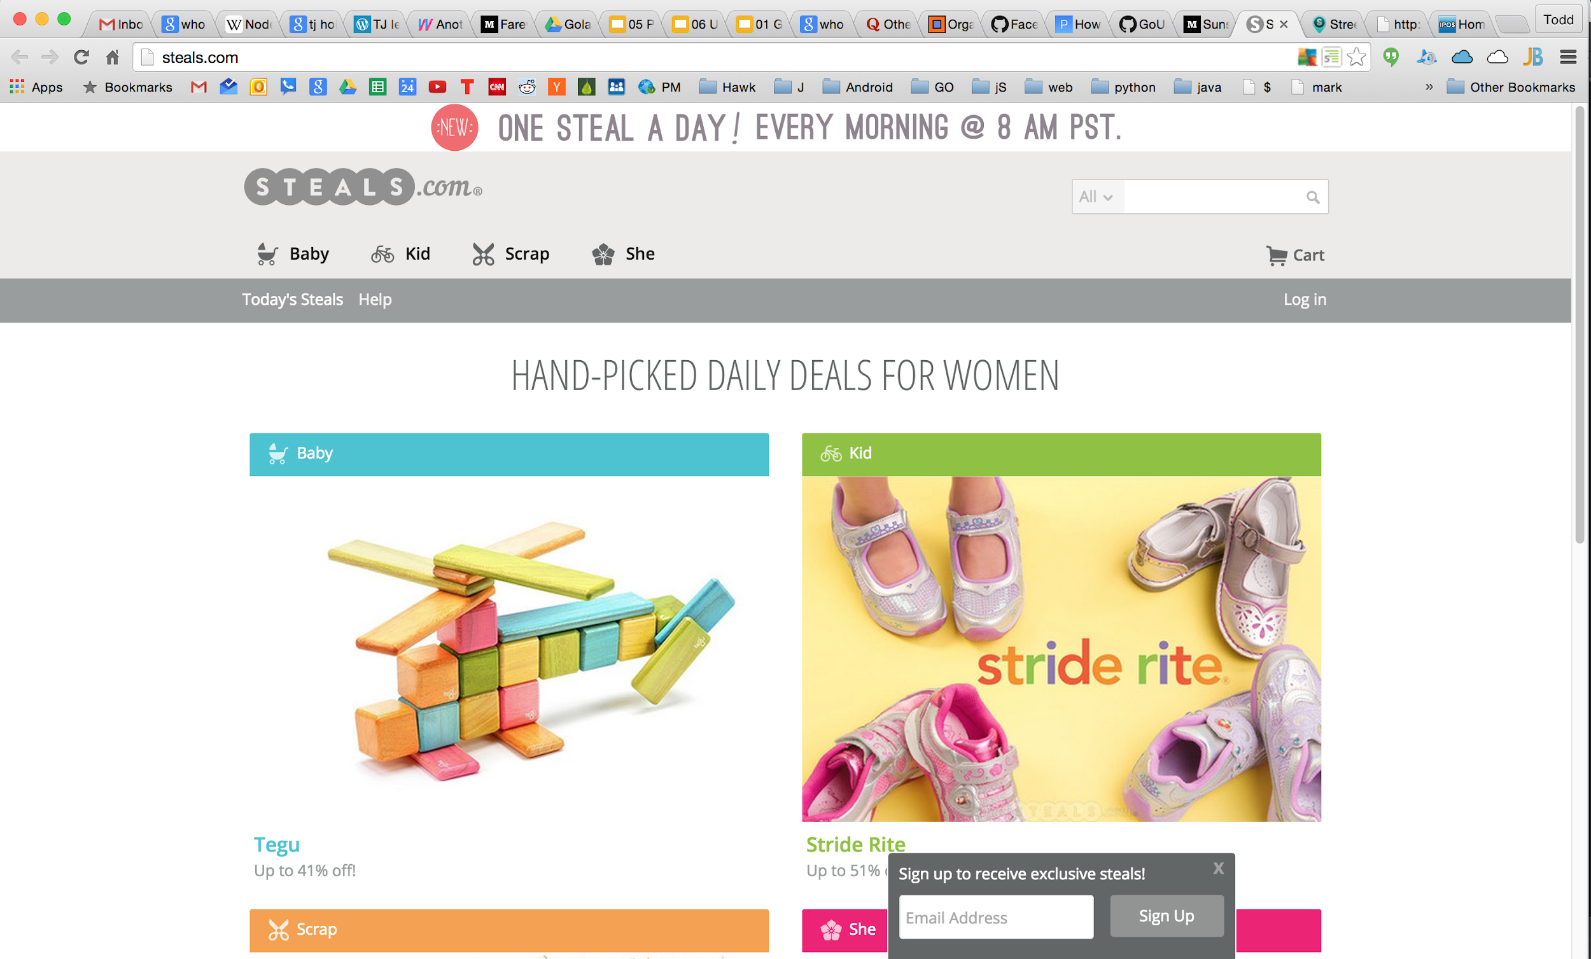

Slide 53
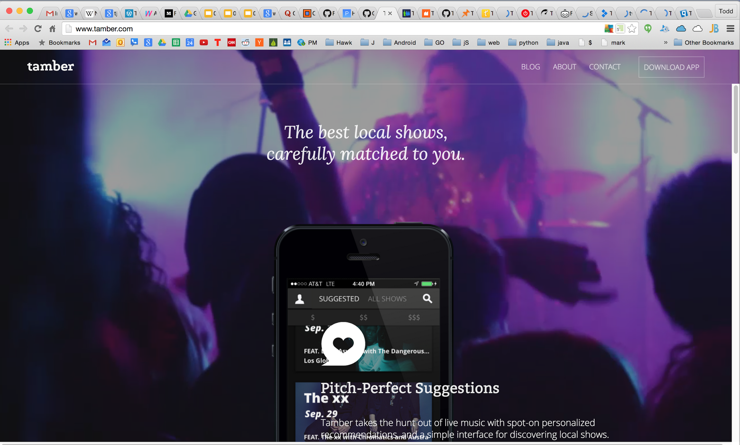

Slide 54
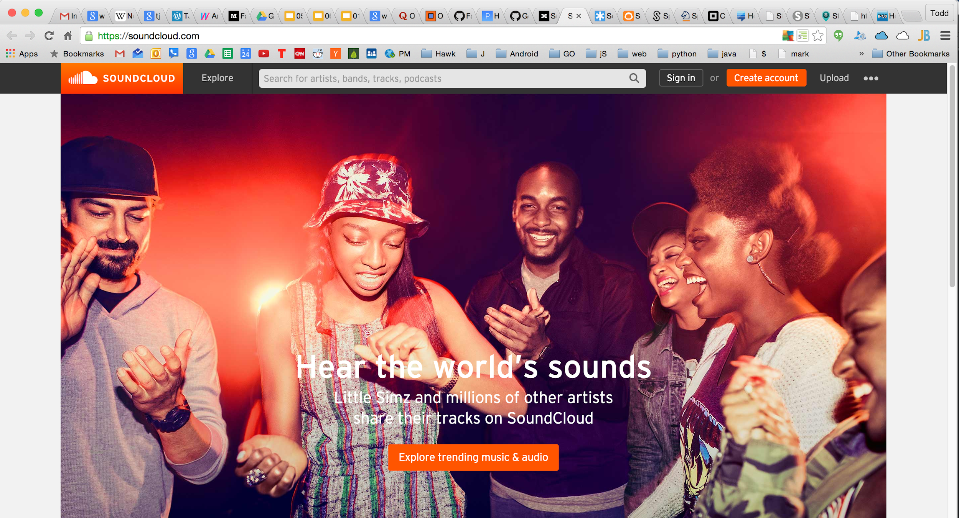

Slide 55
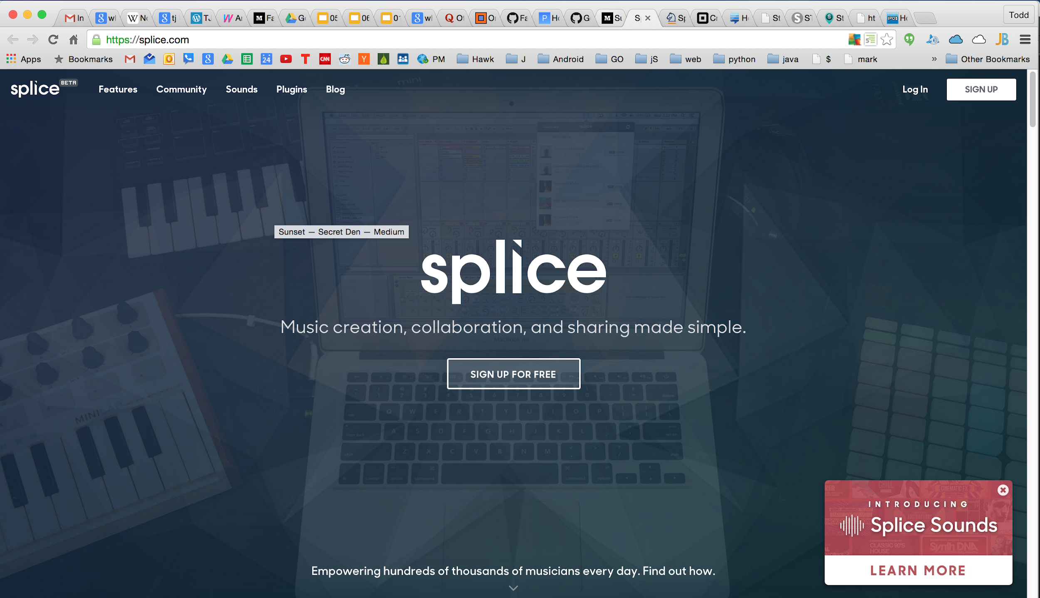

Slide 56
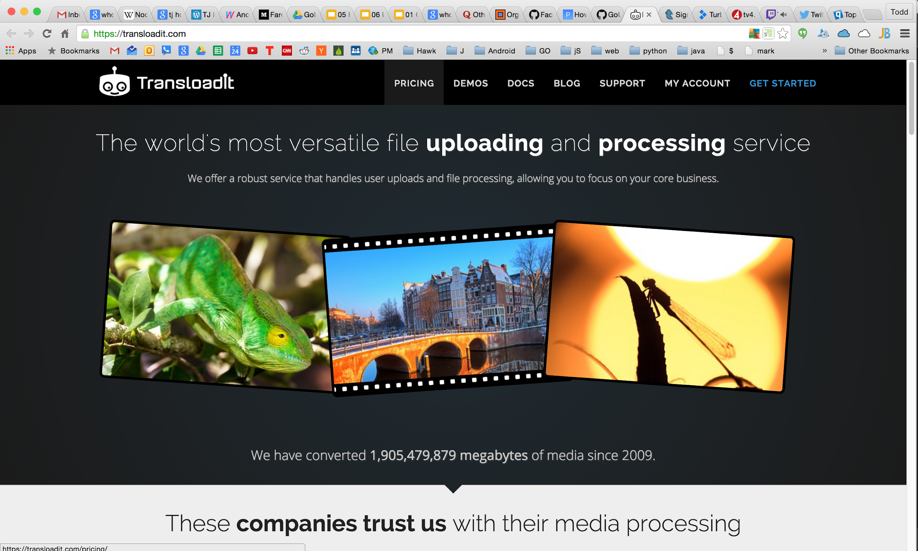

Slide 57
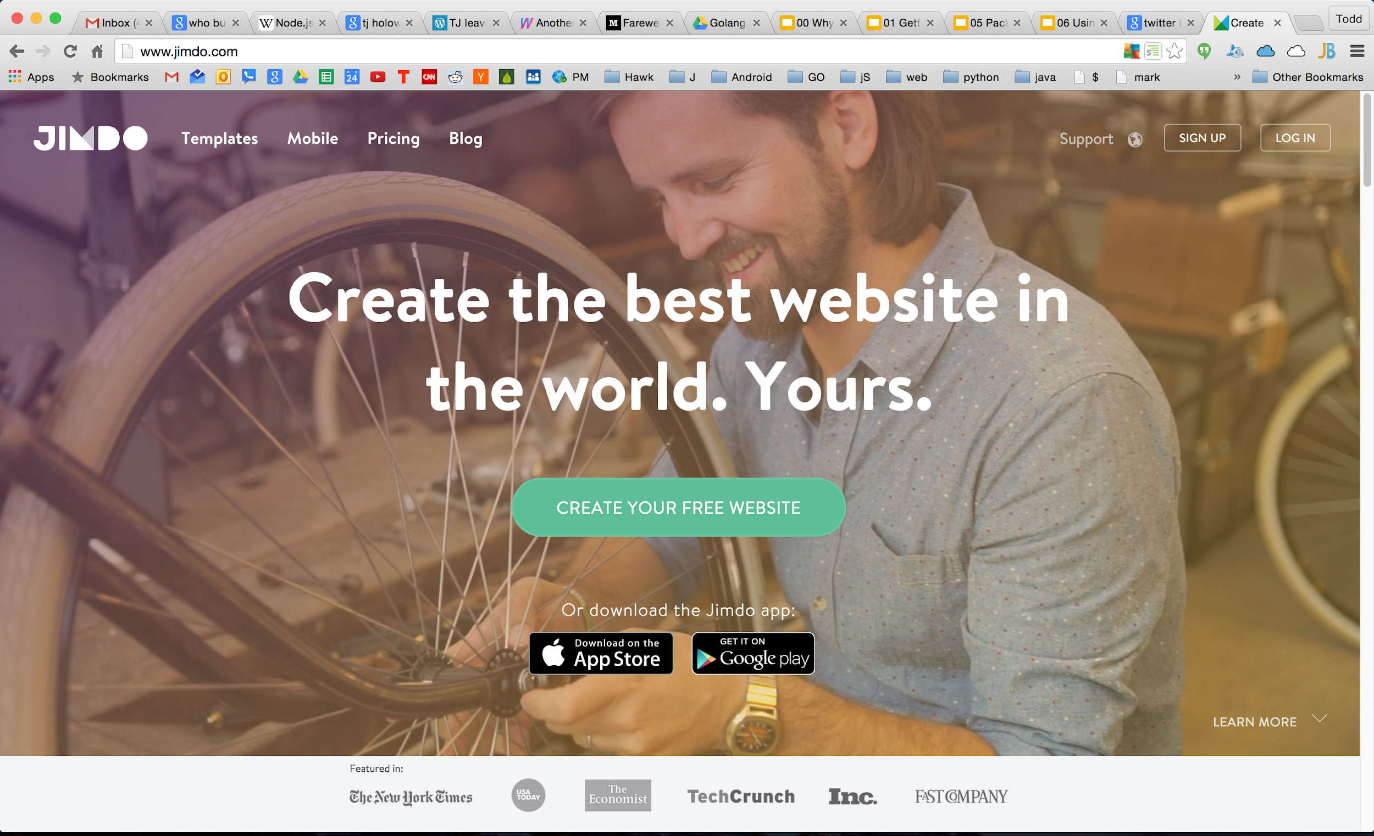

Slide 58
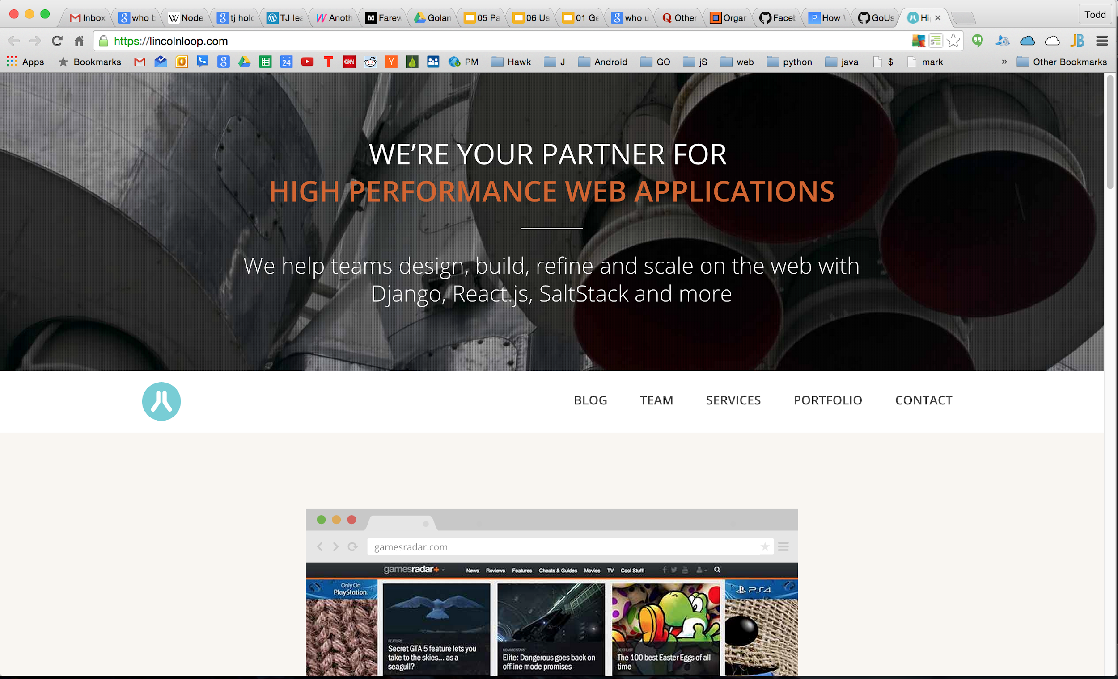

Slide 59
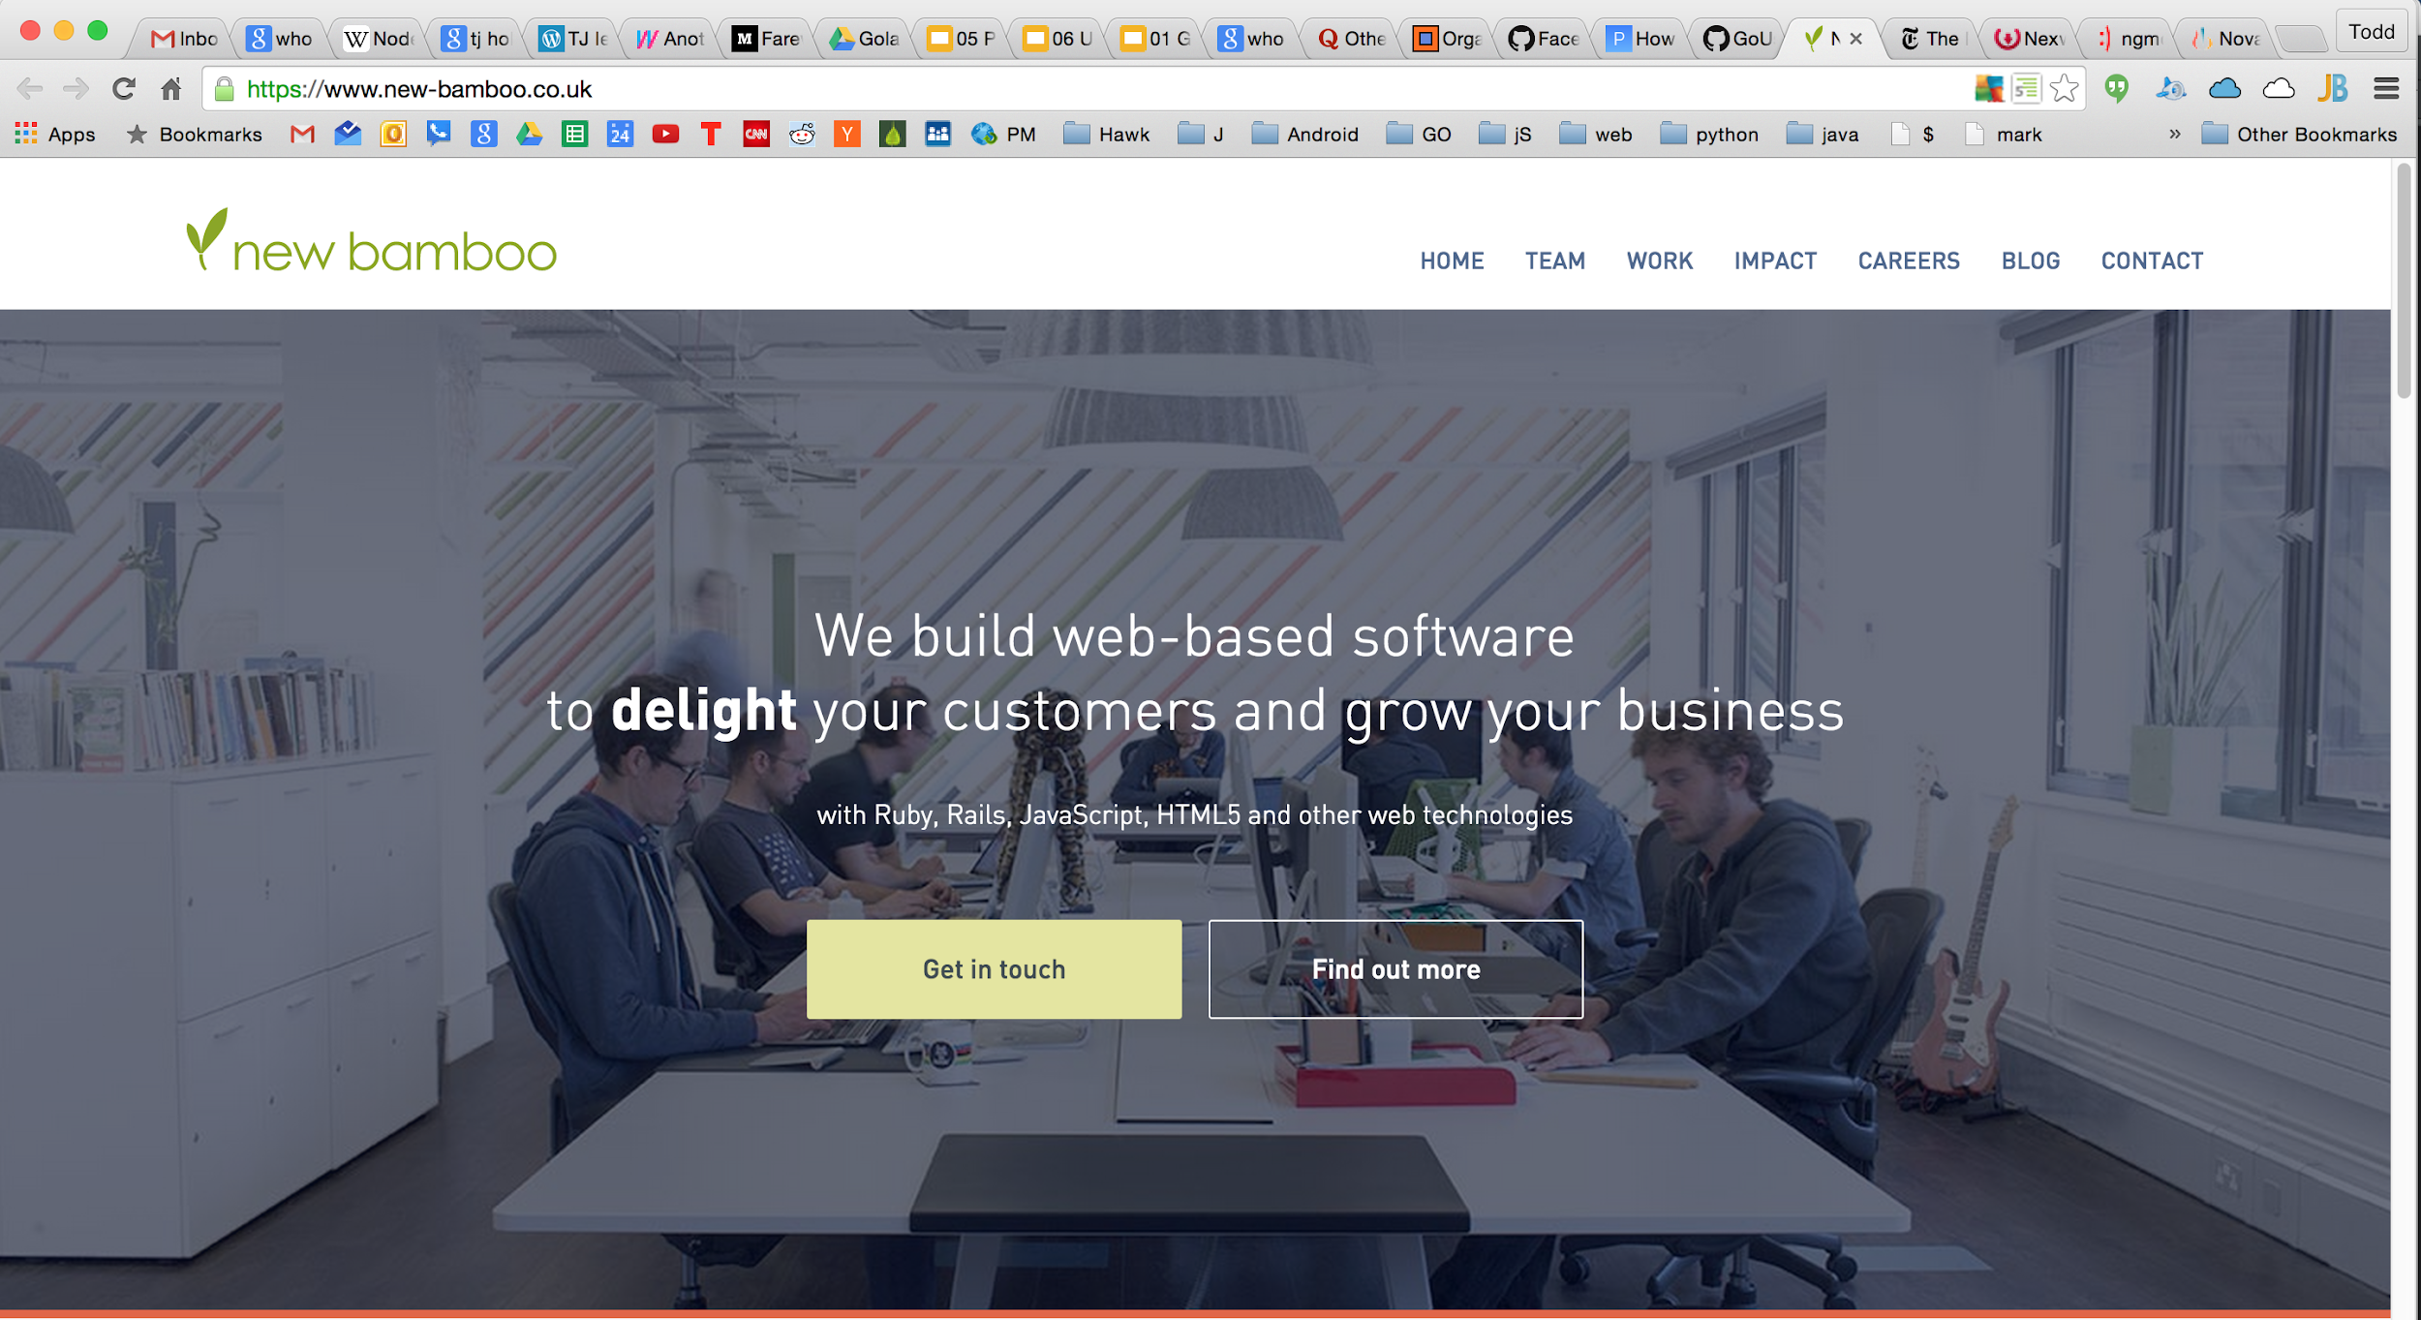

Slide 60
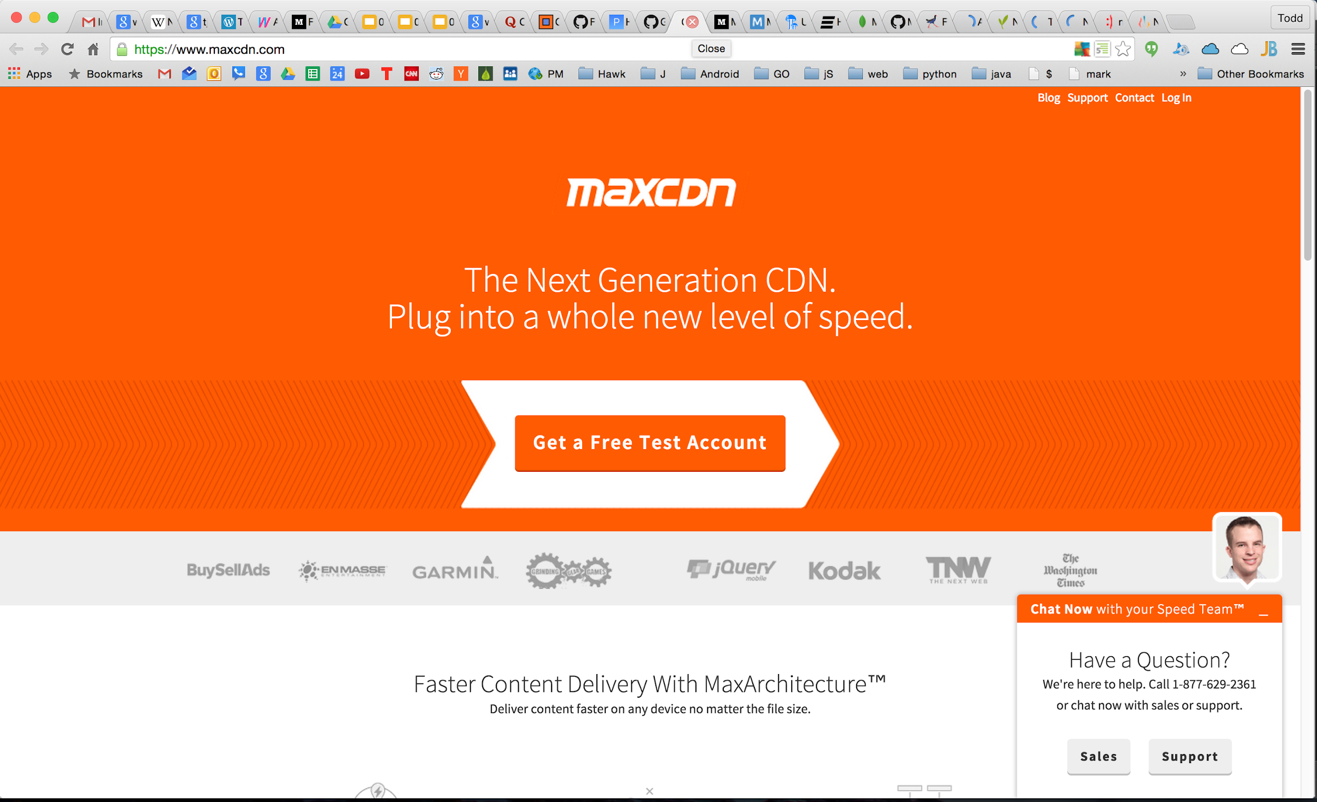

Slide 61
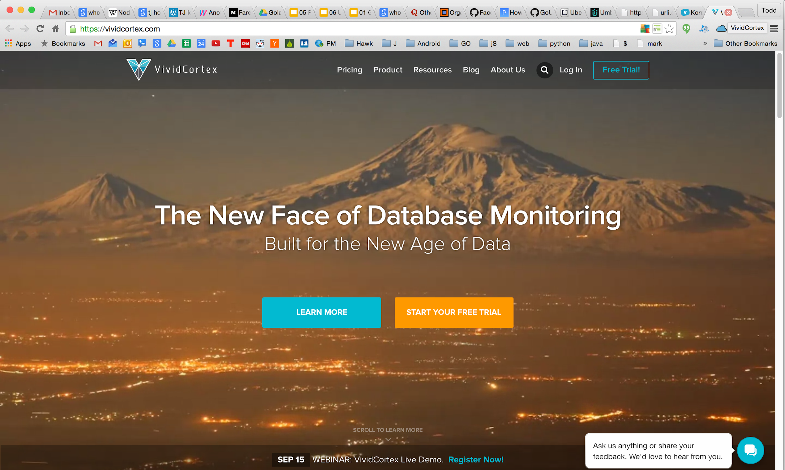

Slide 62
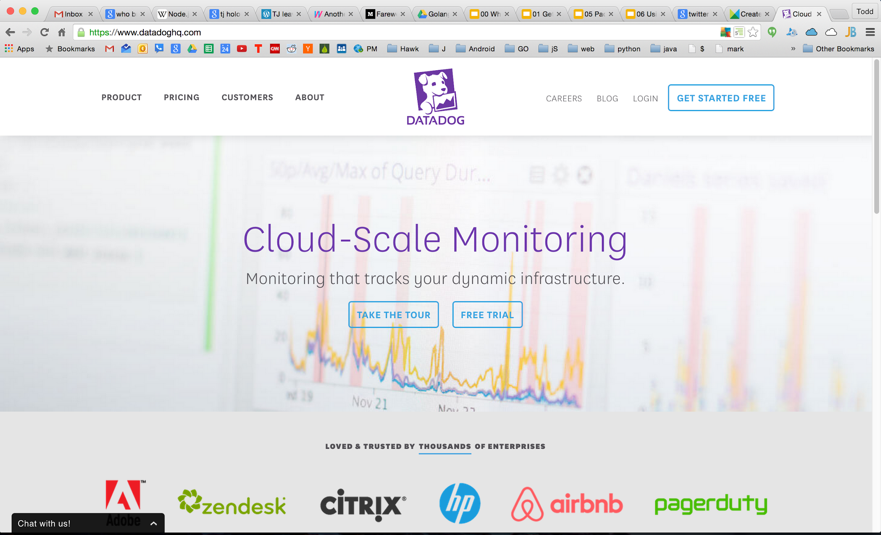

Slide 63
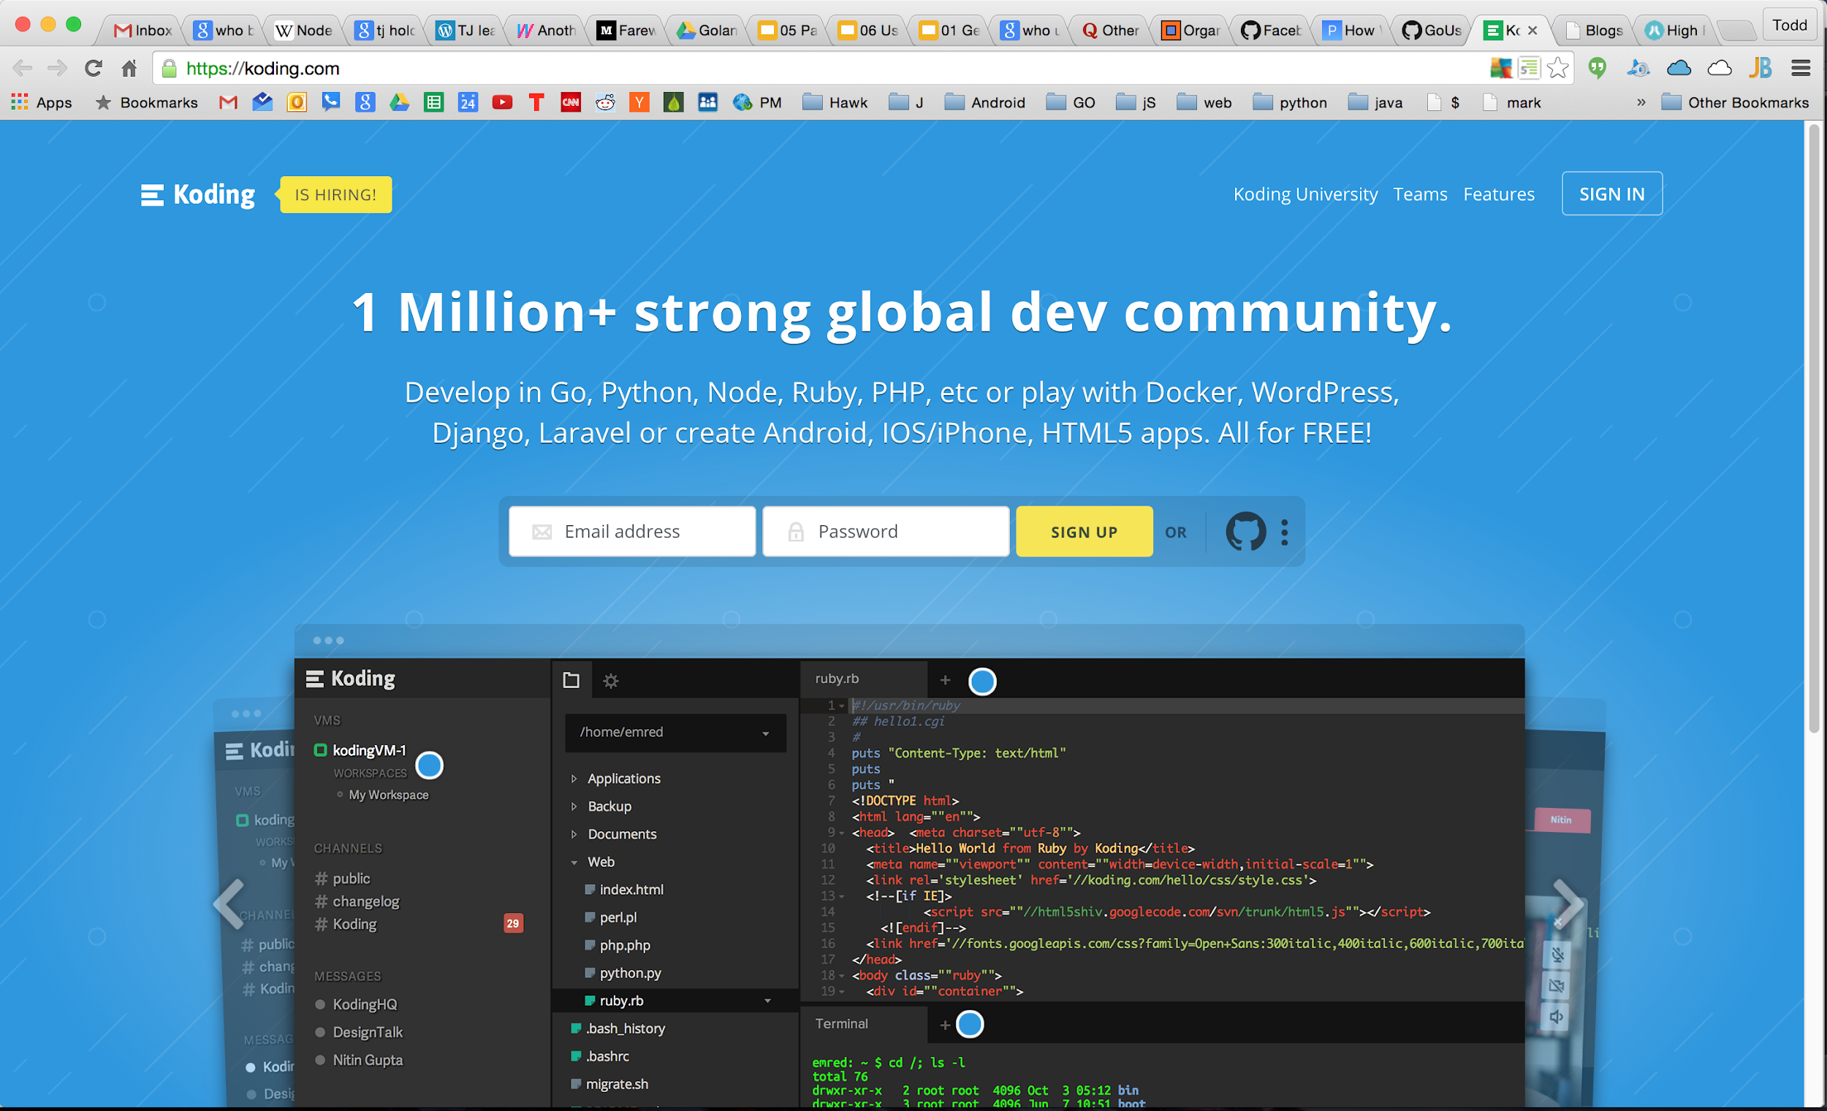

Slide 64
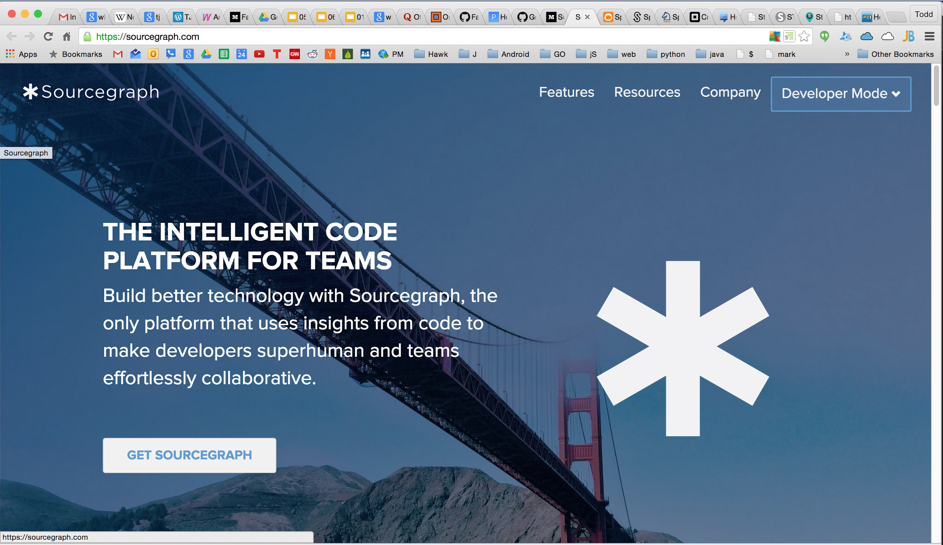

Slide 65
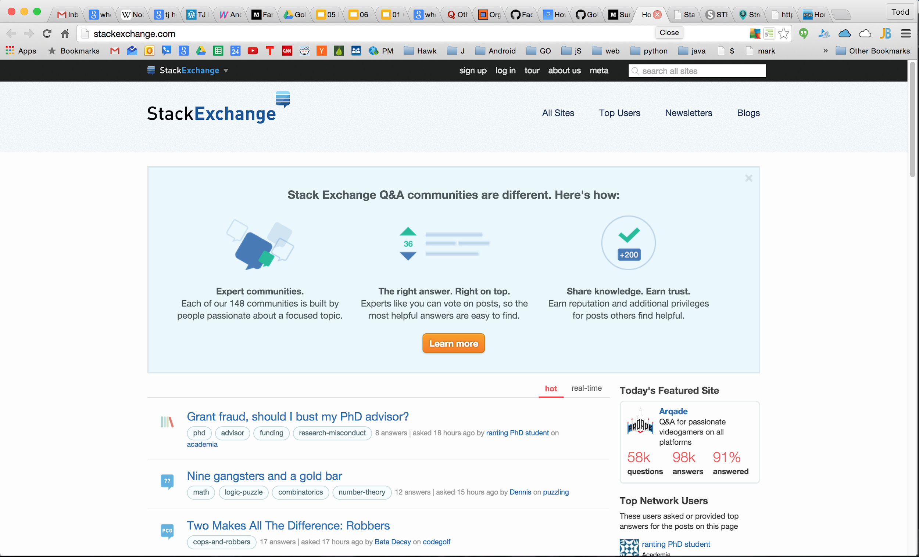

Slide 66
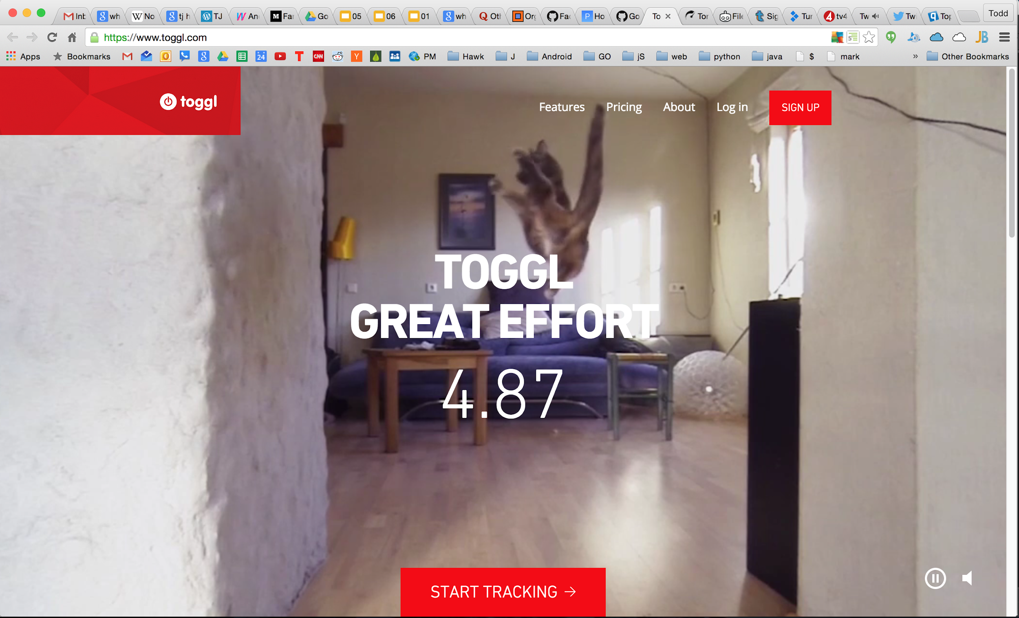

Slide 67


Slide 68
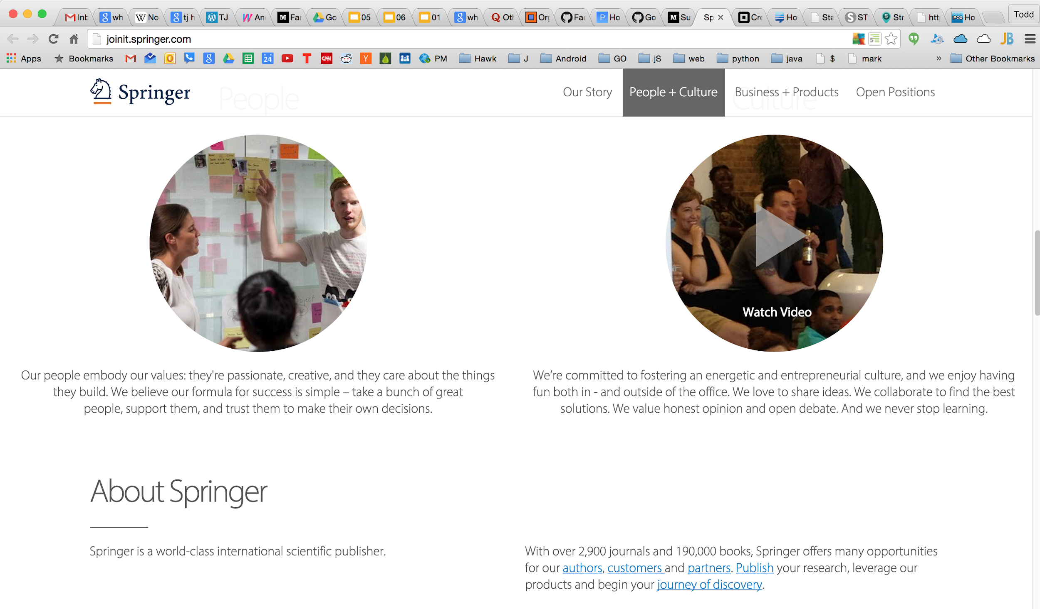

Slide 69
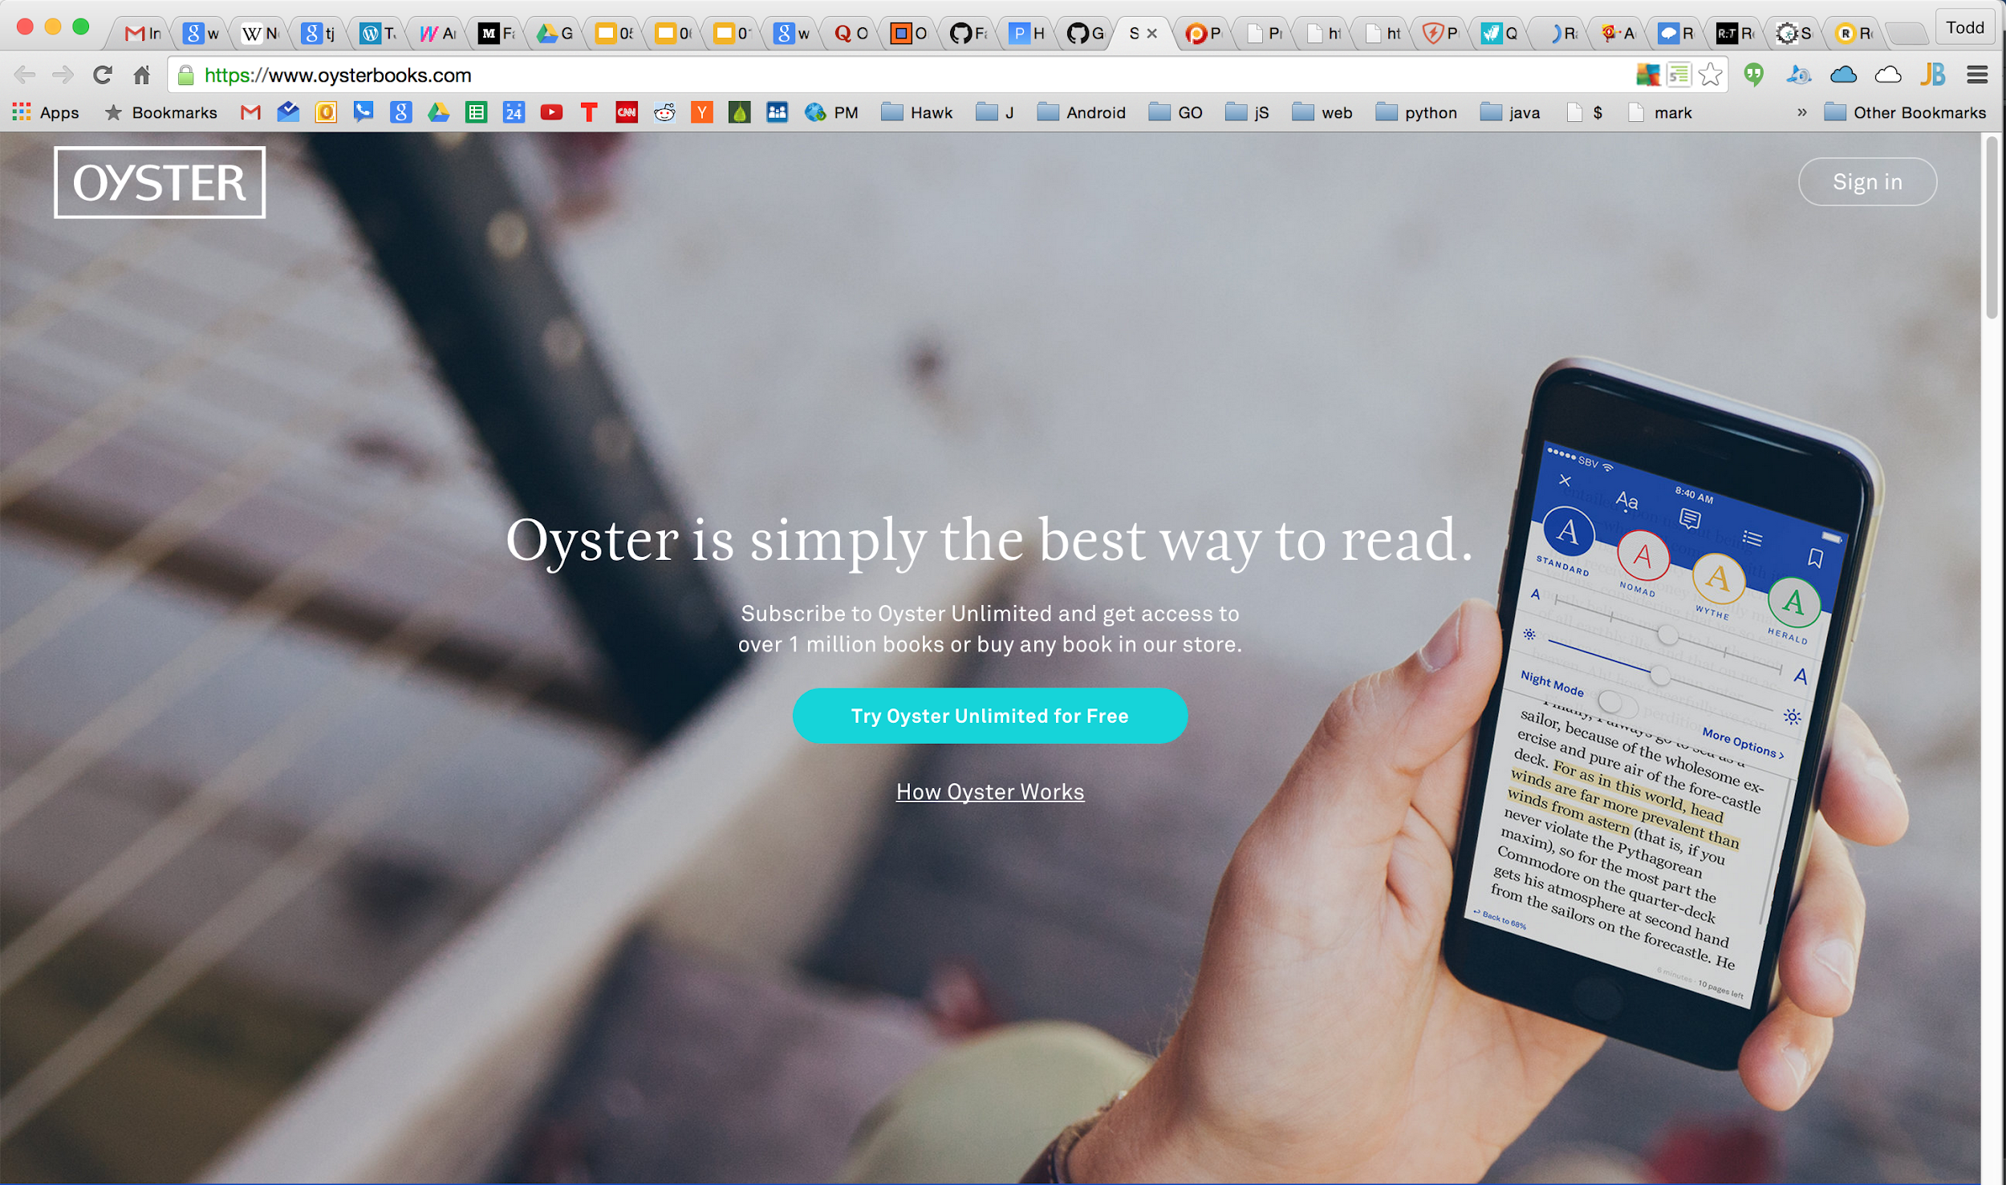

Slide 70
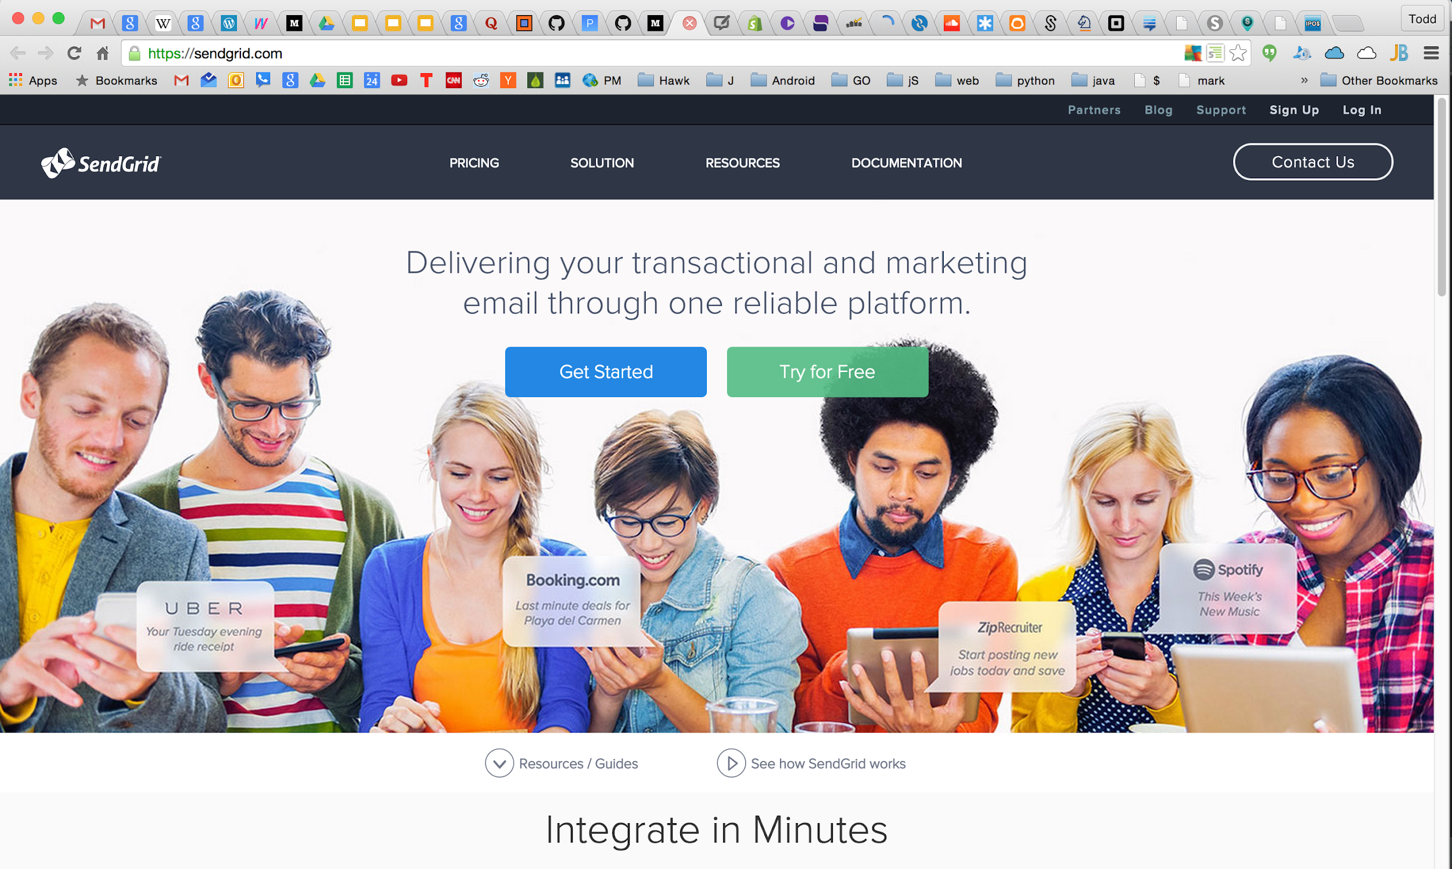

Slide 71
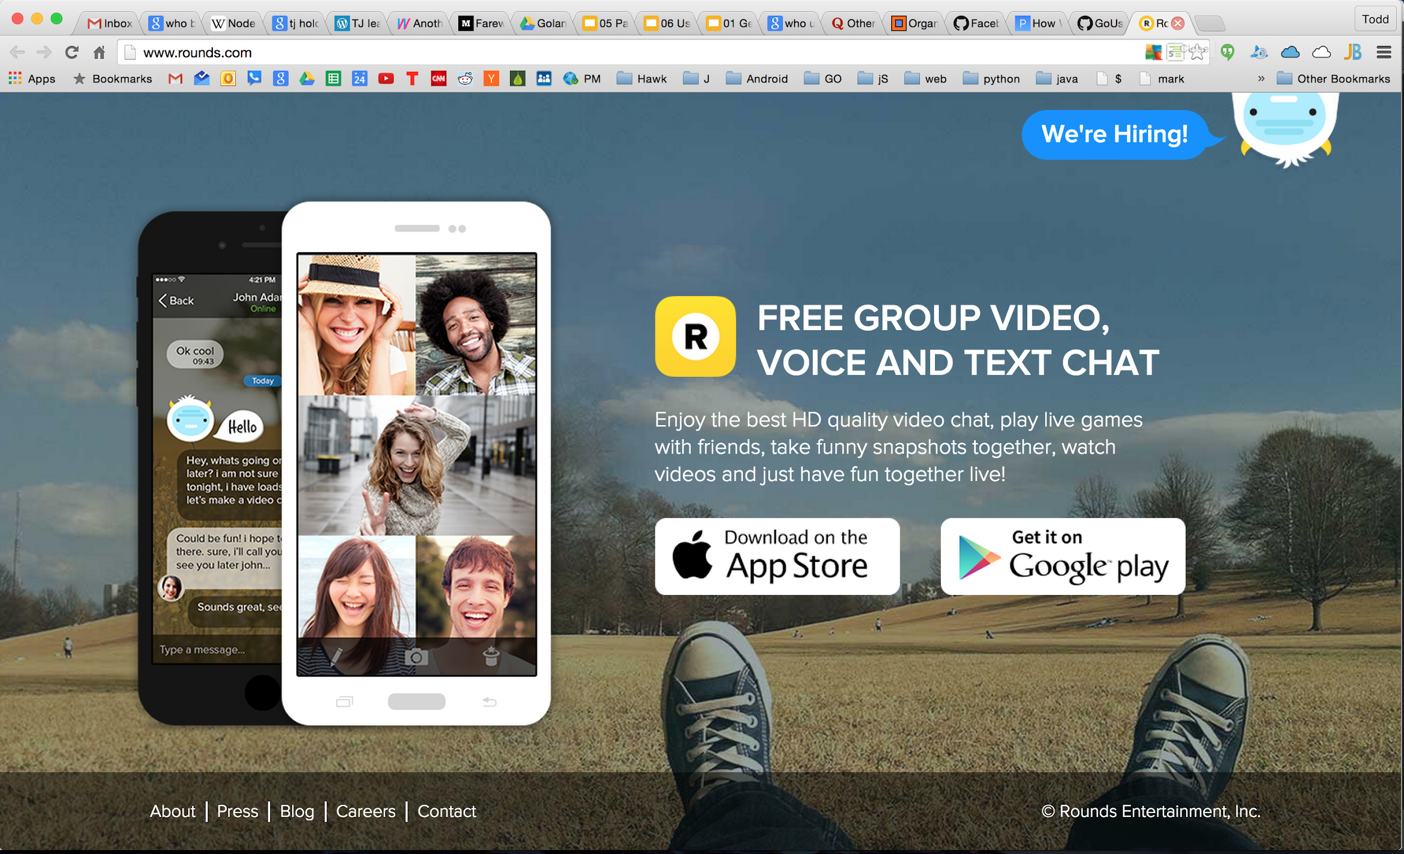

Slide 72
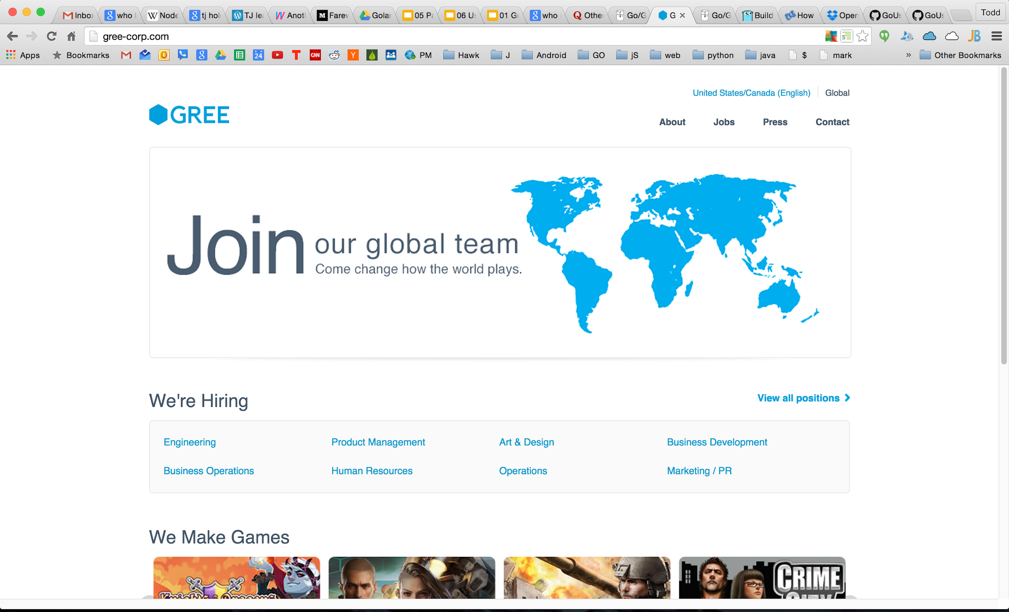

Slide 73
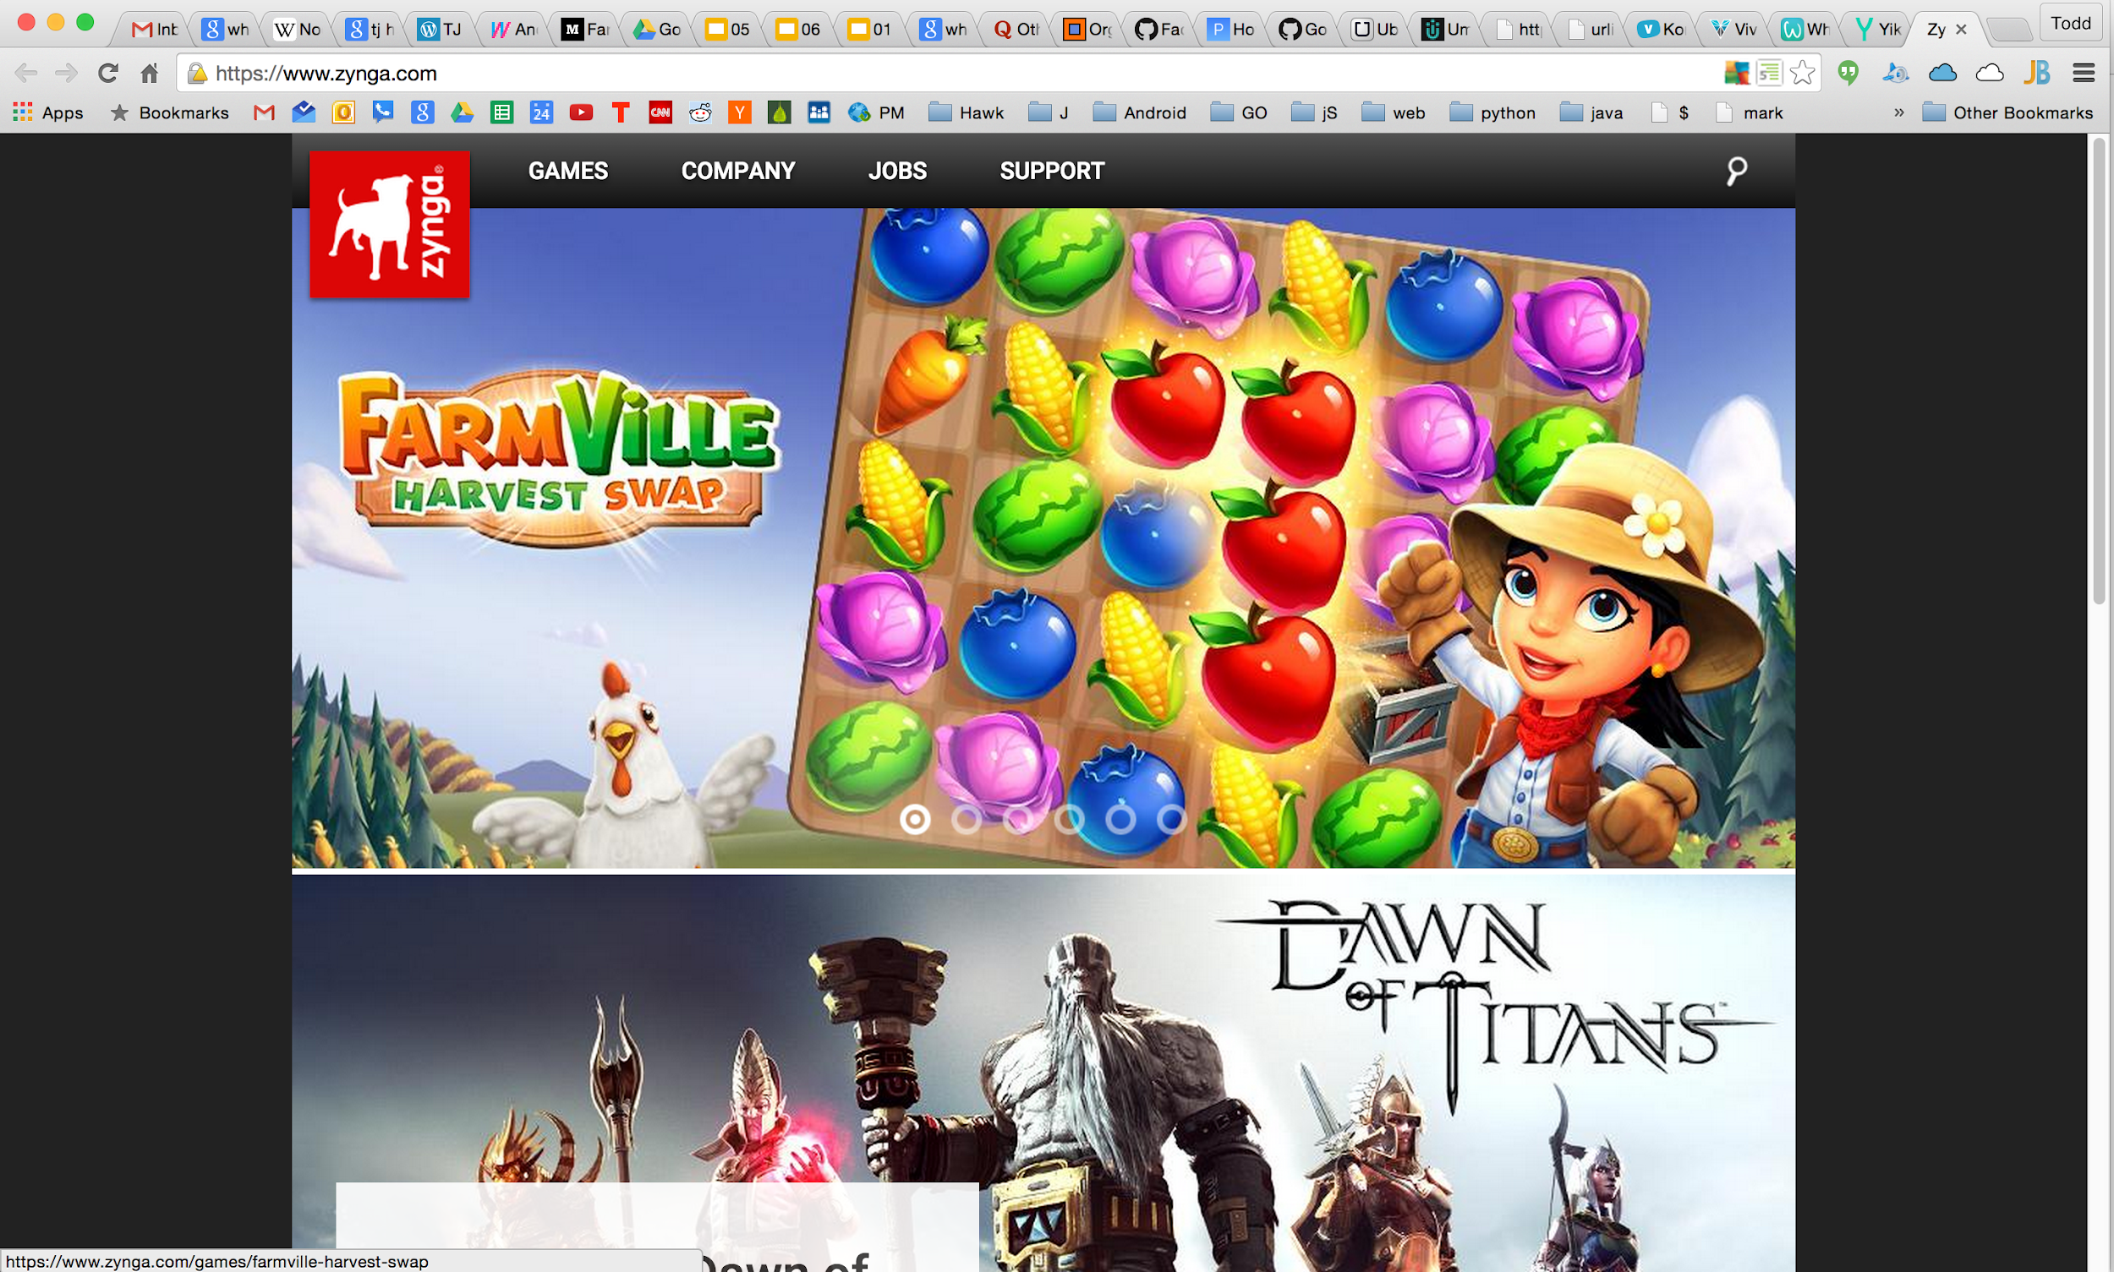

Slide 74
Farewell Node.js
Notes:
https://medium.com/@tjholowaychuk

Slide 75
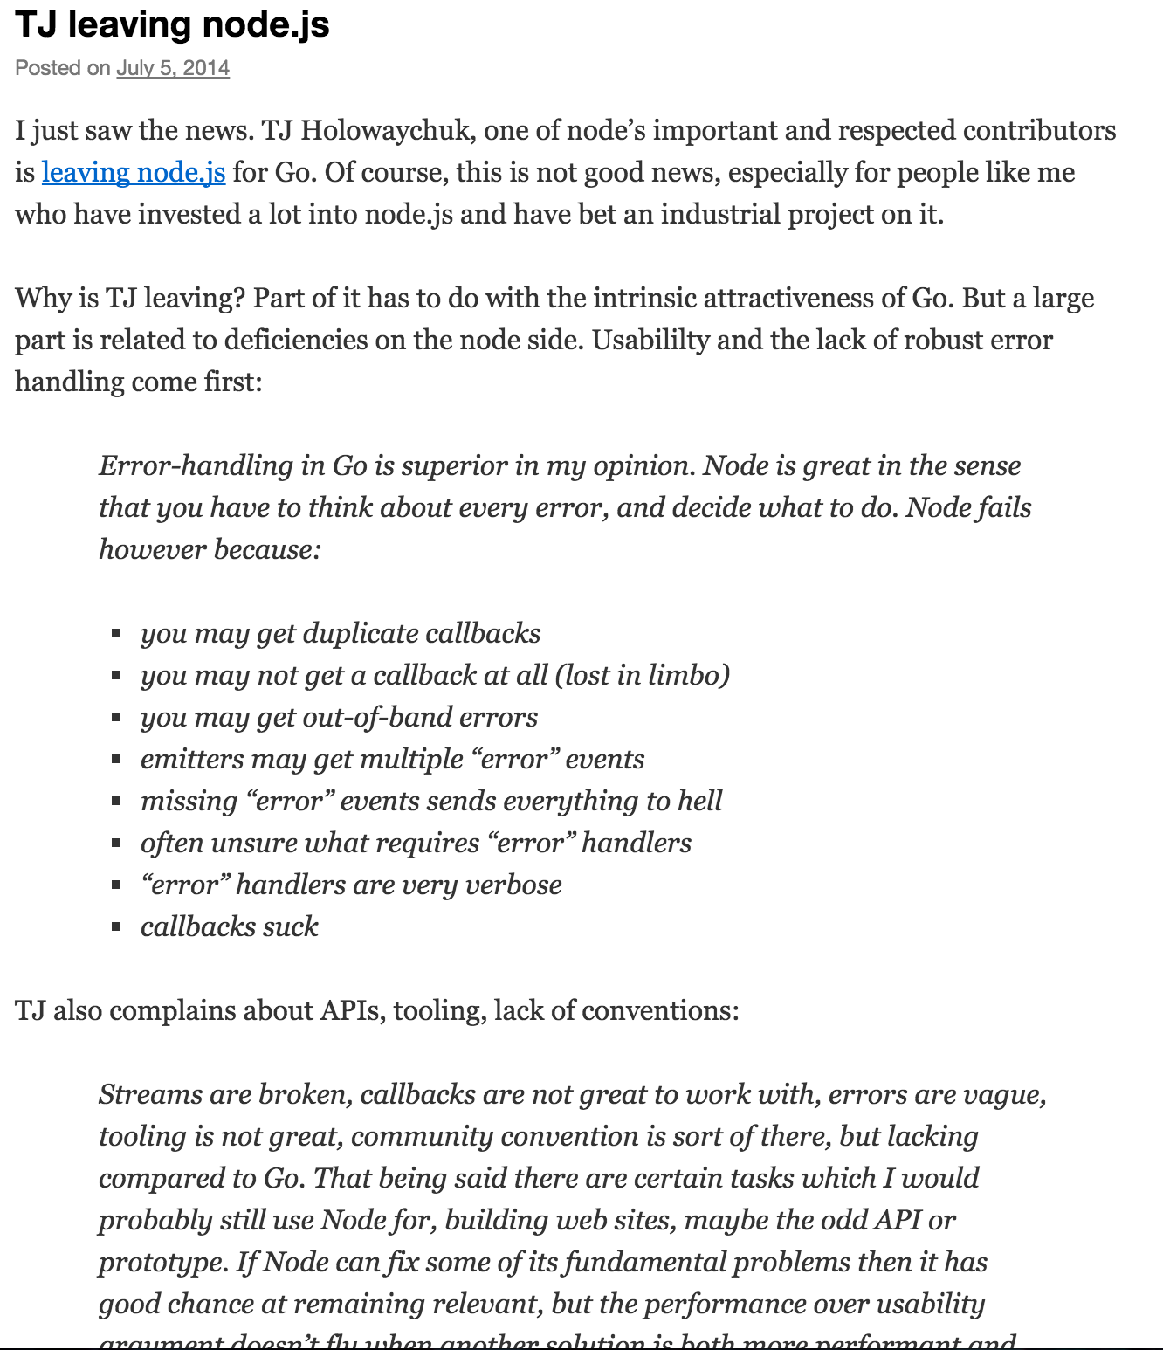
Notes:
https://bjouhier.wordpress.com/2014/07/05/tj-leaving-node-js/

Slide 76
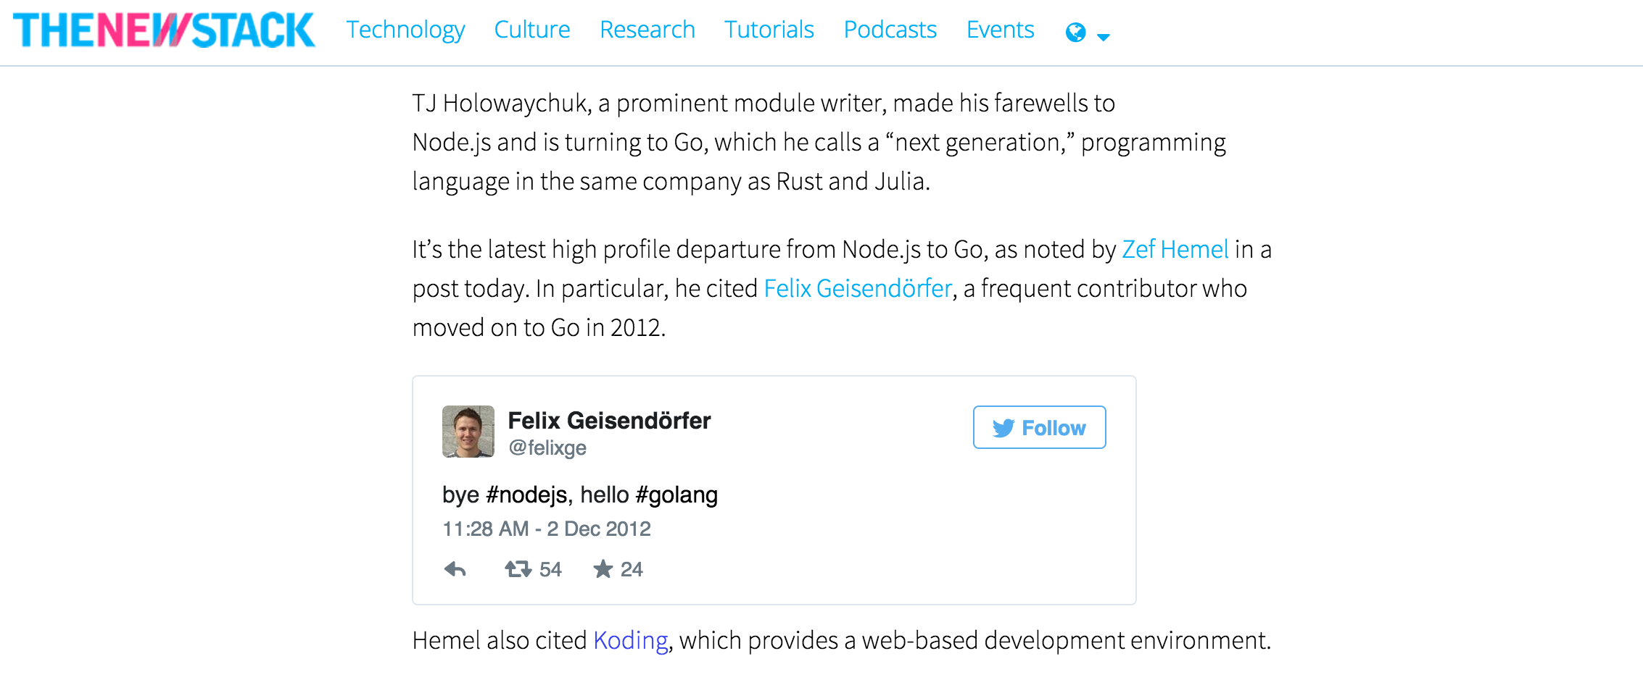
Notes:
http://thenewstack.io/another-respected-developer-says-farewell-to-node-js-and-hello-to-go/

Slide 77
What other language is used for all of these?
web apps
network servers
mobile applications
machine learning
image processing
load balancers
system admin
hardware
scripts
crypto

Slide 78
“Initially, our Go-based system ran on 20 servers, with 20 million real-time connections in total. The system sent 2 million messages a day. That system now runs on 400 servers, supporting 200 million+ real-time connections. It now sends over 10 billion messages daily.”
The Go Blog

Slide 79
Review
Golang is awesome
Holy crap! A lot of great companies are already using golang
You should have already learned Golang a year ago
but at least you’re starting now.

Slide 80
resources

Slide 81
https://goo.gl/PHKgO7

Slide 82
toddmcleod@gmail.com

Slide 83
letsgo
udemy todd mcleod

Slide 84
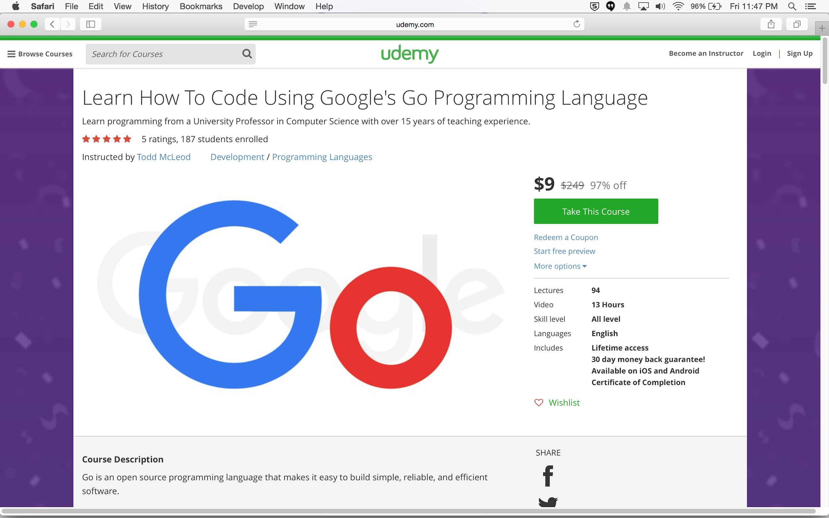

Slide 85
sources

Slide 86
Golang / Go Jobs & Developers
Currently using Go
Other than Google, what companies are using Go in production?
Go: 90% Perfect, 100% of the time.
Google's Go language is off to a great start, but still has work ahead (3/2015)
The Go Blog

Slide 87
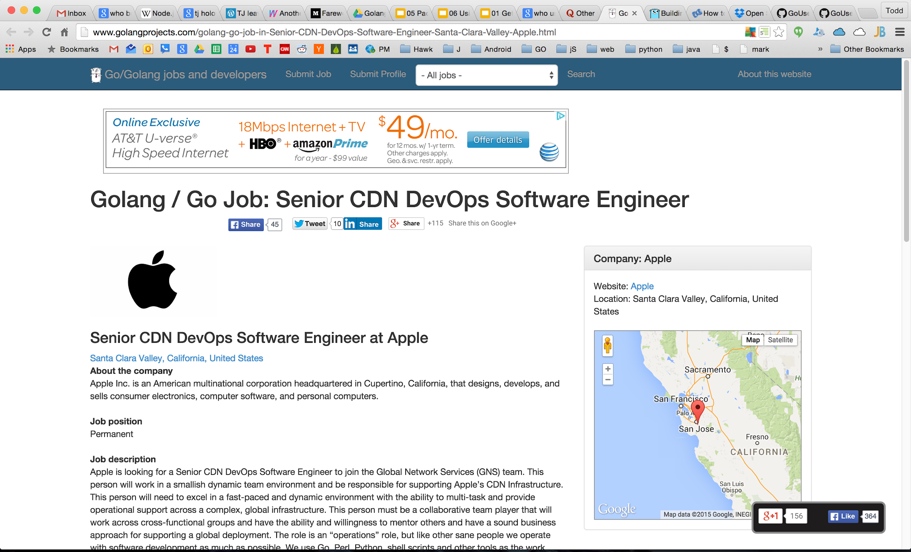

Slide 88
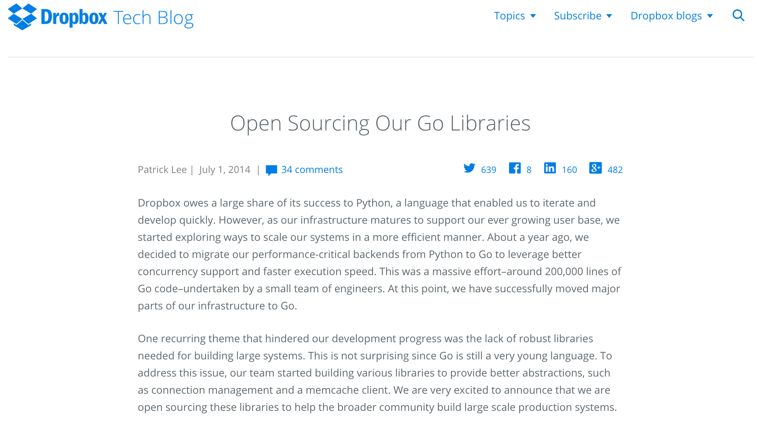

Slide 89
Do Less. Enable More.
Russ Cox
Tech Lead for the Go project and the Go team at Google, July 2015
http://blog.golang.org/open-source

Slide 90
Go & Web
http://stackoverflow.com/research/developer-survey-2015

Slide 91
